Slide 1
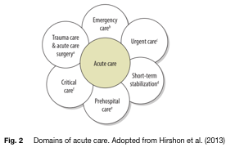

Slide 2
Prehospital care
Emergency care
Short-term stabilisation
Acute surgery and trauma
Critical care
Acute care

Slide 3
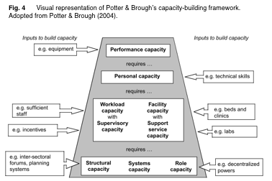

Slide 4
Fig. 5 Search terms applied to databases
Area of interest | Search terms
Human resources in acute care | “Human resources” OR “personnel” OR “workforce” OR “manpower” AND “healthcare”
 | AND
 | “Acute care” OR “Intensive care” OR critical care OR “Emergency care” “Emergency and Essential Surgical Care” “National ED Inventories Survey”
Literature review | Healthcare system Healthcare structure Healthcare delivery Coverage Community health workers Healthcare expenditure Resource-restricted Resource poor LMIC Low-income, middle-income Sepsis Natural hazards Education, training, skills mix Migration, mobility, distribution Accessibility Competence, efficacy, performance, motivation, retention Healthcare policy Healthcare planning

Slide 5
Fig. 6 Adapted framework for capacity building. Based on Potter & Brough (2004).
Performance | Mentions availability of consumables, diagnostics, or therapeutics with regards to acute care delivery
Personal | Mentions education, training and skill-mix with regards to acute medicine Mentions paraprofessional training Mentions salary, competence or motivation
Workload | Mentions precise numbers of acute care personnel Mentions patient volume or attendance Mentions distribution of personnel across shifts Mentions degree of personnel shortage (if present)
Supervisory | Mentions oversight and senior decision-making regarding acute care delivery Describes presence of protocols, triaging systems, or clinical guidelines
Facility | Mentions presence and adequacy of prehospital services Mentions bed numbers and other hospital facilities Mentions presence and adequacy of basic utilities such as running water, electricity and blood banks
Role | Discusses autonomy of staff with regards to decision-making over shift allocation, service design and staff appointments
Support | Mentions accessibility to supportive facilities (e.g. laboratory, radiology) or other specialties

Slide 6
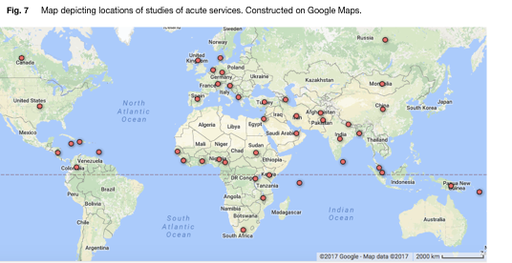

Slide 7
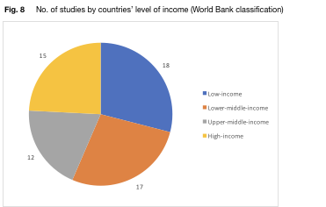

Slide 8
