Slide 1
Knowledge bleed,
NamesforLife, and
Rumsfeld’s axiom
George M. Garrity, Catherine Lyons & James R. Cole
Michigan State University and
NamesforLife, LLC
Funding for this research has been provide by the US Department of Energy, Grants No. DE-FG02-04ER63933 and DE-FG02-99ER62848, the National Science Foundation Award No. DBI-0328255 and the Michigan University Commercialization Initiative (MUCI) program. Portions of this work are covered under US and foreign patents (pending) and are the intellectual property of the Michigan State University Board of Trustees.
For further information contact garrity@msu.edu
Notes:
The theme of this symposium is biodiversity, presumably micobial, but not necessarily restricted to microbial biodiversity. While my colleagues will be speaking about organismal aspects of biodiversity, I would like to turn my attention to output of such studies: data, information, and knowledge. Once we go into the environment and collect specimens, how these are described and become a part of the scientific record, how and where the information is reported and how it is used over time.
I would also like to discuss some external events, outside the field of biodiversity that shape not only what we do, but how we do it, and how we report our results. Not only have the methods of assessing biodiversity changed dramatically over the last 20, 10, 5, and even 1 year, so too have the types and volume of data that are generated and the manner in the data and their interpretation are distributed. We are inundated with both data and publications. It is this portion of the biodiversity equation on which I would like to focus for my allotted time

Slide 2
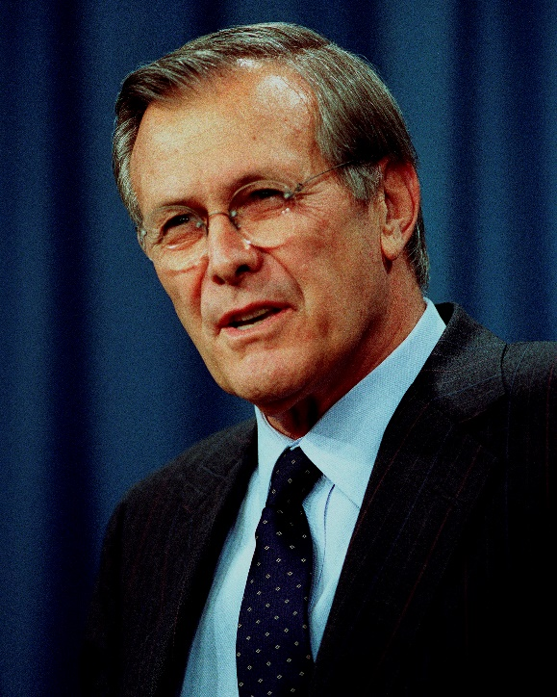
“…because as we know, there are known knowns; there are things we know we know. We also know there are known unknowns; that is to say we know there are some things we do not know. But there are also unknown unknowns -- the ones we don't know we don't know.”
Rumsfeld’s axiom and knowledge bleed
Notes:
In accepting my invitation from the chairs of the session, I was asked to speak my mind, perhaps even saying a few things that might be controversial. In keeping with this charge, I can think of few individuals more controversial than Donald Rumsfeld.
He has a way of crystallizing complex ideas into succinct and memorable phrases. One that is particularly relevant is his phrase about knowledge (which actually paraphrases Aristotle(?)) .

Slide 3
The knowledge gradient
Unknown
unknowns
Unknown
knowns
Known
unknowns
Known
knowns
Semantic resolution provides a mechanism to combat knowledge bleed
Knowledge bleed results is a loss of knowledge that has already been gained
Basic and applied research advances knowledge
Notes:
Rumsfeld points out that there are different scops of knowledge. There are those things that we know that we clearly understand. There are also those things that are totally unknown to us. Research helps to increase our fundamental knowledge, pushing back the boundaries of our ignorance and creating a third category of knowledge, those things that we do not yet know, but which we know we do not know them.
It is our opinion that within the knowledge gradient, there exists another type of unknown - representing knowledge that was once known, but has been forgotten or lost over time. We call this the unknown knowns. At first glance, this might seem an implausible, but it represents a very real risk, not only in biodiversity studies, but in most fields, with the biosciences being the among the most prone to this problem, because of the extraordinary Growth in many of the sub disciplines, and the accompanying way of reporting results. A principle source of this knowledge loss arises in the very terminology we use to discuss and report our findings. Unless each worker clearly understands the underlying concepts that are used to describe their work in reference to that of others, discovery and retrieval of important findings becomes more difficult, if not impossible. Part of the problem lies in the sheer volume of material that is appearing in “print”. The second involves the rapidly* evolving terms that are used to describe biologically relevant concepts at the various levels.

Slide 4

Service related science
STM publishing
Bioinformatics
End-users
Products and services
External forces
Systematic and
systems microbiology

Slide 5
We do quagmires
Notes:
The Alteromonadales represent an interesting text case for demonstrating how one could apply DOIs to solve the problems associated with changes in nomenclature and taxonomy of a particular group. The family was effectively defined by Garrity et al in version 1.0 of the Taxonomic Outline and independently by Ivanova and Mikhailov in 2001 and is formed on the genus Alteromonas, which serves as the type genus for the family and class. Alteromonas was initially circumscribed by Bauman et al, in 1972 and subsequently emended (although not formally in all cases) on more than 15 occasions through the addition 20 species. Nineteen of these species were subsequently moved to four other genera, two of which are also members of the Alteromonas (sensu Garrity et al.) and two genera are members of the family “Oceanospirillacea”, “Class Oceanospirillales”. Some of the later proposals also yield three heterotypic synonyms, two homotypic synonyms, the subdivision of one species into two subspecies which were subsequently rejoined following a move to another genus, the subsequent subdivision of one reassigned species into five distinct species in that genus, and one orthographic correction that was required to correct an error when latinizing a species name. Thus, the original 20 species of Alteromonas have appeared under a total of 64 different names in five genera, two families and two classes.

Slide 6
1972
Alteromonas
macleodii^{(T)}
communis
vaga
Notes:
In 1972 Bauman et al propose the Alteromonas to accommodate three species of gram negative

Slide 7
1972 1973
Alteromonas
macleodii^{(T)}
communis
vaga
haloplanktis

Slide 8
1972 1973 1976
Alteromonas
macleodii^{(T)}
communis
vaga
haloplanktis
rubra

Slide 9
1972 1973 1976 1977
Alteromonas
macleodii^{(T)}
communis
vaga
haloplanktis
rubra
citrea

Slide 10
1972 1973 1976 1977 1978
Alteromonas
macleodii^{(T)}
communis
vaga
haloplanktis
rubra
citrea
esperjiana
undina

Slide 11
1972 1973 1976 1977 1978 1979
Alteromonas
macleodii^{(T)}
communis
vaga
haloplanktis
rubra
citrea
esperjiana
undina
aurantia

Slide 12
1972 1973 1976 1977 1978 1979 1981
Alteromonas
macleodii^{(T)}
communis
vaga
haloplanktis
rubra
citrea
esperjiana
undina
aurantia
putrifaciens
hanedai

Slide 13
1972 1973 1976 1977 1978 1979 1981 1982
Alteromonas
macleodii^{(T)}
communis
vaga
haloplanktis
rubra
citrea
esperjiana
undina
aurantia
putrifaciens
hanedai
luteoviolaceae

Slide 14
1972 1973 1976 1977 1978 1979 1981 1982 1984
Oceanosprillum
Marinomonas
Alteromonas
linum^{(T)}
communis^{(T)}
macleodii^{(T)}
japonicum
vaga
communis
minutium
vaga
biejerinckii
haloplanktis
maris
maris
rubra
citrea
maris
williamsae
esperjiana
undina
hiroshimense
aurantia
multiglobiferum
putrifaciens
pelagicum
hanedai
pusillum
luteoviolaceae
commune
jannaschii
kreigii
vagum
Nomenclatural issues
  Homotypic synonymy
  Priority
  Rule 37(a) 1
Data issues
  One to many relationship
Taxonomic issue
  Which one is right?

Slide 15
1972 1973 1976 1977 1978 1979 1981 1982 1984 1986
Oceanosprillum
Marinomonas
Alteromonas
Shewanella
linum^{(T)}
communis^{(T)}
macleodii^{(T)}
putrifaciens^{(T)}
japonicum
vaga
communis
benthica
minutium
vaga
hanedai
biejerinckii
haloplanktis
maris
maris
rubra
citrea
maris
williamsae
esperjiana
undina
hiroshimense
aurantia
multiglobiferum
putrifaciens
pelagicum
hanedai
pusillum
luteoviolaceae
commune
jannaschii
kreigii
vagum

Slide 16
1972 1973 1976 1977 1978 1979 1981 1982 1984 1986 1987
Oceanosprillum
Marinomonas
Alteromonas
Shewanella
linum^{(T)}
communis^{(T)}
macleodii^{(T)}
putrifaciens^{(T)}
japonicum
vaga
communis
benthica
minutium
vaga
hanedai
biejerinckii
haloplanktis
maris
maris
rubra
citrea
maris
williamsae
esperjiana
undina
hiroshimense
aurantia
multiglobiferum
putrifaciens
pelagicum
hanedai
pusillum
luteoviolaceae
commune
denitrificans
jannaschii
kreigii
vagum

Slide 17
1972 1973 1976 1977 1978 1979 1981 1982 1984 1986 1987 1988
Oceanosprillum
Marinomonas
Alteromonas
Shewanella
linum^{(T)}
communis^{(T)}
macleodii^{(T)}
putrifaciens^{(T)}
japonicum
vaga
communis
benthica
minutium
vaga
hanedai
biejerinckii
haloplanktis
maris
maris
rubra
citrea
maris
williamsae
esperjiana
undina
hiroshimense
aurantia
multiglobiferum
putrifaciens
pelagicum
hanedai
pusillum
luteoviolaceae
commune
denitrificans
jannaschii
colwelliana
kreigii
vagum

Slide 18
1972 1973 1976 1977 1978 1979 1981 1982 1984 1986 1987 1988 1990
Oceanosprillum
Marinomonas
Alteromonas
Shewanella
linum^{(T)}
communis^{(T)}
macleodii^{(T)}
putrifaciens^{(T)}
japonicum
vaga
communis
benthica
minutium
vaga
hanedai
biejerinckii
haloplanktis
colwelliana
maris
maris
rubra
citrea
maris
williamsae
esperjiana
undina
hiroshimense
aurantia
multiglobiferum
putrifaciens
pelagicum
hanedai
pusillum
luteoviolaceae
commune
denitrificans
jannaschii
colwelliana
kreigii
tetradonis
vagum
biejerinckii
pelagicum
maris
hiroshimense

Slide 19
1972 1973 1976 1977 1978 1979 1981 1982 1984 1986 1987 1988 1990 1992
Oceanosprillum
Marinomonas
Alteromonas
Shewanella
linum^{(T)}
communis^{(T)}
macleodii^{(T)}
putrifaciens^{(T)}
japonicum
vaga
communis
benthica
minutium
vaga
hanedai
biejerinckii
haloplanktis
colwelliana
maris
maris
rubra
algae
citrea
maris
williamsae
esperjiana
undina
Nomenclatural issue
  Non-type strains
hiroshimense
aurantia
multiglobiferum
putrifaciens
pelagicum
hanedai
pusillum
luteoviolaceae
commune
denitrificans
jannaschii
colwelliana
kreigii
tetradonis
vagum
atlantica
biejerinckii
pelagicum
carageenovora
maris
hiroshimense

Slide 20
1972 1973 1976 1977 1978 1979 1981 1982 1984 1986 1987 1988 1990 1992 1995
Oceanosprillum
Marinomonas
Alteromonas
Shewanella
linum^{(T)}
communis^{(T)}
macleodii^{(T)}
putrifaciens^{(T)}
japonicum
vaga
communis
benthica
minutium
vaga
hanedai
biejerinckii
haloplanktis
colwelliana
maris
maris
rubra
algae
citrea
maris
williamsae
esperjiana
undina
hiroshimense
aurantia
multiglobiferum
putrifaciens
pelagicum
hanedai
pusillum
luteoviolaceae
commune
denitrificans
jannaschii
colwelliana
kreigii
tetradonis
vagum
atlantica
biejerinckii
pelagicum
carageenovora
Nomenclatural issues
  Heterotypic synonymy
Data issue
  Many to many relationship
Taxonomic issue
  Which one is right?
distincta
maris
hiroshimense
fuliginea

Slide 21
1972 1973 1976 1977 1978 1979 1981 1982 1984 1986 1987 1988 1990 1992 1995
Oceanosprillum
Marinomonas
Alteromonas
Shewanella
Pseudoalteromonas
linum^{(T)}
communis^{(T)}
macleodii^{(T)}
putrifaciens^{(T)}
haloplanktis
haloplanktis^{(T)}
japonicum
vaga
communis
benthica
minutium
vaga
hanedai
haloplanktis
tetradonis
biejerinckii
haloplanktis
colwelliana
maris
maris
rubra
algae
atlantica
citrea
aurantia
maris
williamsae
esperjiana
carrageenovora
undina
citrea
hiroshimense
aurantia
esperjiana
multiglobiferum
putrifaciens
luteoviolacea
pelagicum
hanedai
nigrifaciens
pusillum
luteoviolaceae
pisicida
commune
denitrificans
rubra
jannaschii
colwelliana
undina
kreigii
tetradonis
vagum
atlantica
biejerinckii
pelagicum
carageenovora
distincta
maris
hiroshimense
fuliginea

Slide 22
1972 1973 1976 1977 1978 1979 1981 1982 1984 1986 1987 1988 1990 1992 1995 1997
Oceanosprillum
Marinomonas
Alteromonas
Shewanella
Pseudoalteromonas
linum^{(T)}
communis^{(T)}
macleodii^{(T)}
putrifaciens^{(T)}
haloplanktis
haloplanktis^{(T)}
japonicum
vaga
communis
benthica
minutium
vaga
hanedai
haloplanktis
tetradonis
biejerinckii
haloplanktis
colwelliana
maris
maris
rubra
algae
atlantica
citrea
aurantia
maris
williamsae
esperjiana
carrageenovora
undina
citrea
hiroshimense
aurantia
esperjiana
multiglobiferum
putrifaciens
luteoviolacea
pelagicum
hanedai
nigrifaciens
pusillum
luteoviolaceae
pisicida
commune
denitrificans
rubra
jannaschii
colwelliana
undina
kreigii
tetradonis
antartica
vagum
atlantica
biejerinckii
pelagicum
carageenovora
distincta
maris
hiroshimense
fuliginea
elyakoviii

Slide 23
1972 1973 1976 1977 1978 1979 1981 1982 1984 1986 1987 1988 1990 1992 1995 1997 2000
Oceanosprillum
Marinomonas
Alteromonas
Shewanella
Pseudoalteromonas
linum^{(T)}
communis^{(T)}
macleodii^{(T)}
putrifaciens^{(T)}
haloplanktis
haloplanktis^{(T)}
japonicum
vaga
communis
benthica
minutium
mediterannea
vaga
hanedai
haloplanktis
tetradonis
biejerinckii
haloplanktis
colwelliana
maris
maris
rubra
algae
atlantica
citrea
fridgidimarina
aurantia
maris
williamsae
esperjiana
geldimarina
carrageenovora
undina
woodyii
citrea
hiroshimense
aurantia
amazonensis
esperjiana
multiglobiferum
putrifaciens
baltica
luteoviolacea
pelagicum
hanedai
oneidensis
nigrifaciens
pusillum
luteoviolaceae
pealeana
pisicida
commune
denitrificans
violacea
rubra
jannaschii
colwelliana
undina
kreigii
tetradonis
antartica
vagum
atlantica
bacteriolytica
biejerinckii
pelagicum
carageenovora
prydzensis
distincta
tunicata
maris
hiroshimense
fuliginea
distincta
elyakoviii
elyakovii
peptidolytica

Slide 24
1972 1973 1976 1977 1978 1979 1981 1982 1984 1986 1987 1988 1990 1992 1995 1997 2000 2001
Oceanosprillum
Marinomonas
Alteromonas
Shewanella
Pseudoalteromonas
linum^{(T)}
communis^{(T)}
macleodii^{(T)}
putrifaciens^{(T)}
haloplanktis
haloplanktis^{(T)}
japonicum
vaga
communis
benthica
minutium
mediterannea
vaga
hanedai
haloplanktis
tetradonis
biejerinckii
haloplanktis
colwelliana
maris
maris
rubra
algae
atlantica
citrea
fridgidimarina
aurantia
maris
williamsae
esperjiana
geldimarina
carrageenovora
undina
woodyii
citrea
hiroshimense
aurantia
amazonensis
esperjiana
multiglobiferum
putrifaciens
baltica
luteoviolacea
pelagicum
hanedai
oneidensis
nigrifaciens
pusillum
luteoviolaceae
pealeana
pisicida
commune
denitrificans
violacea
rubra
jannaschii
colwelliana
japonica
undina
kreigii
tetradonis
antartica
vagum
atlantica
bacteriolytica
biejerinckii
pelagicum
carageenovora
prydzensis
distincta
tunicata
maris
hiroshimense
fuliginea
distincta
elyakoviii
elyakovii
peptidolytica
tetrodonis

Slide 25
1972 1973 1976 1977 1978 1979 1981 1982 1984 1986 1987 1988 1990 1992 1995 1997 2000 2001 2002
Oceanosprillum
Marinomonas
Alteromonas
Shewanella
Pseudoalteromonas
linum^{(T)}
communis^{(T)}
macleodii^{(T)}
putrifaciens^{(T)}
haloplanktis
haloplanktis^{(T)}
japonicum
vaga
communis
benthica
minutium
mediterannea
vaga
hanedai
haloplanktis
tetradonis
biejerinckii
haloplanktis
colwelliana
maris
maris
rubra
algae
atlantica
citrea
fridgidimarina
aurantia
maris
williamsae
esperjiana
geldimarina
carrageenovora
undina
woodyii
citrea
hiroshimense
aurantia
amazonensis
esperjiana
multiglobiferum
putrifaciens
baltica
luteoviolacea
pelagicum
hanedai
oneidensis
nigrifaciens
pusillum
luteoviolaceae
pealeana
pisicida
commune
denitrificans
violacea
rubra
jannaschii
colwelliana
japonica
undina
kreigii
tetradonis
denitrificans
antartica
vagum
atlantica
livingstonensis
bacteriolytica
biejerinckii
pelagicum
carageenovora
alleyanna
prydzensis
distincta
tunicata
maris
hiroshimense
fuliginea
distincta
elyakoviii
elyakovii
peptidolytica
tetrodonis

Slide 26
1972 1973 1976 1977 1978 1979 1981 1982 1984 1986 1987 1988 1990 1992 1995 1997 2000 2001 2002 2004
Oceanosprillum
Marinomonas
Alteromonas
Shewanella
Pseudoalteromonas
linum^{(T)}
communis^{(T)}
macleodii^{(T)}
putrifaciens^{(T)}
haloplanktis
haloplanktis^{(T)}
japonicum
vaga
communis
benthica
minutium
mediterannea
vaga
hanedai
haloplanktis
tetradonis
biejerinckii
primoryensis
haloplanktis
colwelliana
maris
maris
rubra
algae
atlantica
citrea
fridgidimarina
aurantia
maris
williamsae
esperjiana
geldimarina
carrageenovora
undina
woodyii
citrea
hiroshimense
aurantia
amazonensis
esperjiana
multiglobiferum
putrifaciens
baltica
luteoviolacea
pelagicum
hanedai
oneidensis
nigrifaciens
pusillum
luteoviolaceae
pealeana
pisicida
commune
denitrificans
violacea
rubra
jannaschii
colwelliana
japonica
undina
kreigii
tetradonis
denitrificans
antartica
vagum
atlantica
livingstonensis
bacteriolytica
biejerinckii
pelagicum
carageenovora
alleyanna
prydzensis
distincta
mariniintestina
tunicata
maris
hiroshimense
fuliginea
saire
distincta
elyakoviii
schlegeliana
elyakovii
stellipolaris
gaetbuli
peptidolytica
litorea
5 others
tetrodonis
12 others

Slide 27
1972 1973 1976 1977 1978 1979 1981 1982 1984 1986 1987 1988 1990 1992 1995 1997 2000 2001 2002 2004 2005
Oceanosprillum
Marinomonas
Alteromonas
Shewanella
Pseudoalteromonas
linum^{(T)}
communis^{(T)}
macleodii^{(T)}
putrifaciens^{(T)}
haloplanktis
haloplanktis^{(T)}
japonicum
vaga
communis
benthica
minutium
mediterannea
vaga
hanedai
haloplanktis
tetradonis
biejerinckii
primoryensis
haloplanktis
colwelliana
maris
maris
rubra
algae
atlantica
citrea
fridgidimarina
aurantia
maris
williamsae
esperjiana
geldimarina
carrageenovora
undina
woodyii
citrea
hiroshimense
aurantia
amazonensis
esperjiana
multiglobiferum
putrifaciens
baltica
luteoviolacea
pelagicum
hanedai
oneidensis
nigrifaciens
pusillum
luteoviolaceae
pealeana
pisicida
commune
denitrificans
violacea
rubra
jannaschii
colwelliana
japonica
undina
kreigii
tetradonis
denitrificans
antartica
vagum
atlantica
livingstonensis
bacteriolytica
biejerinckii
pelagicum
carageenovora
alleyanna
prydzensis
distincta
mariniintestina
tunicata
maris
hiroshimense
fuliginea
saire
distincta
elyakoviii
schlegeliana
elyakovii
stellipolaris
gaetbuli
peptidolytica
litorea
8 others
tetrodonis
2 others
14 others

Slide 28
1972 1973 1976 1977 1978 1979 1981 1982 1984 1986 1987 1988 1990 1992 1995 1997 2000 2001 2002 2004 2005 2006
Oceanosprillum
Marinomonas
Alteromonas
Shewanella
Pseudoalteromonas
linum^{(T)}
communis^{(T)}
macleodii^{(T)}
putrifaciens^{(T)}
haloplanktis
haloplanktis^{(T)}
japonicum
vaga
communis
benthica
minutium
mediterannea
vaga
hanedai
haloplanktis
tetradonis
biejerinckii
primoryensis
haloplanktis
colwelliana
maris
maris
rubra
algae
atlantica
citrea
fridgidimarina
aurantia
maris
williamsae
esperjiana
geldimarina
carrageenovora
undina
woodyii
citrea
hiroshimense
aurantia
amazonensis
esperjiana
multiglobiferum
putrifaciens
baltica
luteoviolacea
pelagicum
hanedai
oneidensis
nigrifaciens
pusillum
luteoviolaceae
pealeana
pisicida
commune
denitrificans
violacea
rubra
jannaschii
colwelliana
japonica
undina
kreigii
tetradonis
denitrificans
antartica
vagum
atlantica
livingstonensis
bacteriolytica
biejerinckii
pelagicum
carageenovora
alleyanna
prydzensis
distincta
mariniintestina
tunicata
maris
hiroshimense
fuliginea
saire
distincta
elyakoviii
schlegeliana
elyakovii
stellipolaris
gaetbuli
peptidolytica
litorea
13 others
tetrodonis
2 others
14 others

Slide 29
May 2004
November 2004
Gammaproteobacteria
Alteromonadales
Alteromonadacea
Colwelliaceae
Idiomarinaceae
Alteromonas
Colwelliaceae
Idiomarina
Aestuariibacter
Thalassomonas
Alishewanella
Colwellia
Ferrimonadacea
Psychromonadaceae
At the species level
18 “emendations”
  21 new species
  19 species reassigned to 4 genera
    3 new combinations
    6 synonyms
    2 species to subspecies
    2 subspecies to species
  50 names, five genera, five families, and two classes but….
  only 5 validly published species.
At the higher level
  1 Family 16 genera -> 8 families 12 genera
1 unclassified genus -> 7 unclassified genera
Which is correct?
Which is supported by the data?
What is the impact on MIGS?
Ferrimonas
Ferrimonas
Psychromonas
Glaciecola
Idiomarina
Marinobacter
Pseudoalteromonadaceae
Marinobacterium
Pseudoalteromonas
Incertae sedis
Microbulbifer
Algicola
Agarvorans
Moritella
Alishewanella
Shewanellaceae
Marinobacter
Pseudoalteromonas
Marinobacterium
Psychromonas
Shewanella
Shewanella
Microbulbifer
Thalassomonas
Moritellaceae
Salinomonas
Incertae sedis
Moritella
Teredinibacter
Teredinibacter

Slide 30
Authority+
Name+
Taxon
Species+
Strain+
Sequence+
Notes:
The key point in this slide is to emphasize that names, taxon concepts and exemplars are independent. Names are fixed in time and are bibliographic events, tied to a particular published description. The taxon concept, however, drifts once it comes into usage, as addition, non=type exemplars are added to the global sample set. There is also a critical need to always tie the data (phenotype/genotype) to the correct source strain.

Slide 31
Priority
Proposals
Source+
Validity
STM
Literature
Governing bodies
Synonymy
Legal
Type
General
Databases
Authority+
Name+
Public
Private
Taxon
Species+
Strain+
Feature+
direct
indirect
Source+
Collections
BRC
GenBank
DDBJ
EMBL
others
GSC Core Phenotype
FAME
Biolog PA
MLST
Images
etc.
BRC

Slide 32
Differing opinions…
Name+
Name+
Name+
Strain+
Strain+
Taxon
Taxon
Species+
Taxon
Strain+
Feature+
Feature+
Feature+
Homotypic synonymy
Heterotypic synonymy

Slide 33
Non-types, clones, environmental sequences
ID+
“Name”+
Feature+
Strain*
Feature+
Environmental sequence
Misidentified taxon
Notes:
When one looks at the environmental data, it becomes difficult in accurately interpreting results across studies, especially when one is dealing with survey data comprised of a singe measurement (eg. a 16S sequence). One of the reasons is that investigators use their own identifier to label the data (and strains). More importantly, many of these labels are not unique,

Slide 34
Top 25 labels on 16S rRNA sequences for type strains
1200
n = 15232 unique sequences
2.74X over defined
1000
800
600
400
200
0
I
1
3
4
5
A
6
7
B
8
10
D
C
9
RB
11
14
12
16
17
B2
Tanzania
Notes:
We are in the process of updating our prototype application. One of the objectives is to identify all of the high quality 16S sequences that have come from type strains held in different collections/BRCs. We believe that such a comprehensive list remains useful for a variety of reasons. However, compiling such a list is problematic, as the GenBank records rarely identify the source organism in such a way that the sequence can be tied to a deposit in a culture collection, and few collections actually publish such a list for their own deposits. In fact, we believe that most collections are unaware which of the cultures in their holdings actually have an associated 16S or other sequence as there is currently no way to harvest this information automatically.
We began with a list of 15232 strain identifers extracted from the Taxonomic Outline, LPN, and the DSMZ LBN. Each term was then passed to a set of automated queries that were run against the RDP database which currently contains >225,000 16S sequences. From this, a candidate list of 15232 sequences were retreived.
The figure above shows what the current names are that are associated with those sequences. Interestingly,

Slide 35
“Identifiers” on Verrucomicrobia 16S rRNA sequences, n=911
Notes:
Recently, we began an examination of several phyla that represented particular challenges for the RDP, the naive Baysian classifier of Qiong et al. and our own SOSCC algorithm. In particular, while numerous sequences are identified as belonging to these phyla, placement is at best challenging as there are very few cultivated representatives on which to base the identifications.
In the case of the Verrucomicrobia, 911 high-quality sequences were available from Genbank that were labeled as members of this phylum. As noted in the previous slide, some “synonymies” occurred. In particular, 551/911 sequences from clones, the environment, and cultivate strains bore the same label, and 734/911 strains were synonyms. Thus, any practical assignment to a meaningful taxon, based on the depositors’ data became virtually impossible.

Slide 36
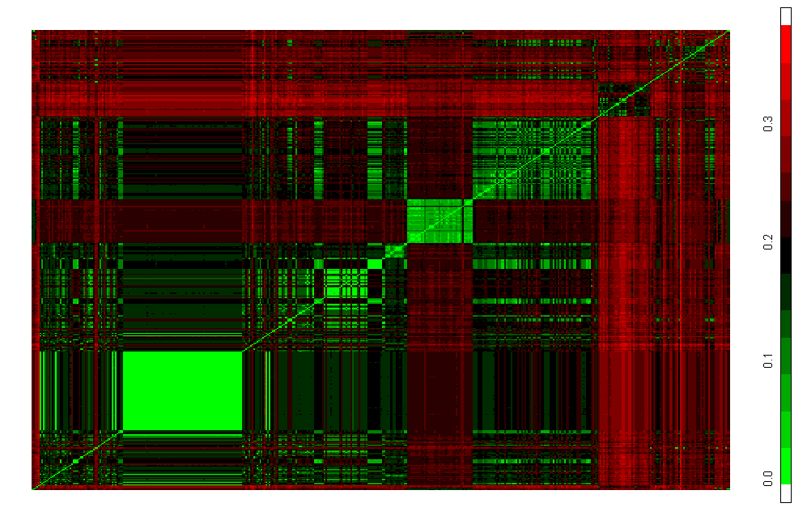
Verrucomicrobia, based on annotation (n=444)
Unclassified
Victivalalles &
Lentisphaeralles
Unclassified
Xiphinematobact
Optitutus
Verrucomicrobia
Proteobacteria
Notes:
We have been using heatmaps of evolutionary distance matrices to visualize sequence similarity and to uncover annotation errors in the 16S sequence data set for about 5 yrs. Last year, we published on the SOSCC algorithm which can undertake this process in an automated manner. What is particularly useful is that the method allows us to examine 10^3 – 10^4 sequences simultaneously, thereby revealing the otherwise hidden structure associated with more distant taxonomic relationships. The major limitations in method at this point in time are hardware associated (max number of pixels on a screen and the lower limits of resolution associated with the typical pointing device.
The method allows to “challenge” the correctness of a taxonomic arrangement of sequences, uncover misplacements and annotation errors, and correctly position unknown sequences in reference to vetted sequences derived from type and non-type strains. Scale bar on the left is evolutionary distance (Jukes Cantor), for the subset of alignable sequences for which complete pair-wise distances could be estimated. Sequences were arranged according to the nomenclatural taxonomy of Garrity et al (release 6.0).
The heatmap reveals numerous taxonomic misplacements that are attributable to annotation errors, misidentification and “synonymies”. Resoltuion of these errors is confounded by the relatively small number of cultivated members within the loosely defined phylum (< 10).

Slide 37
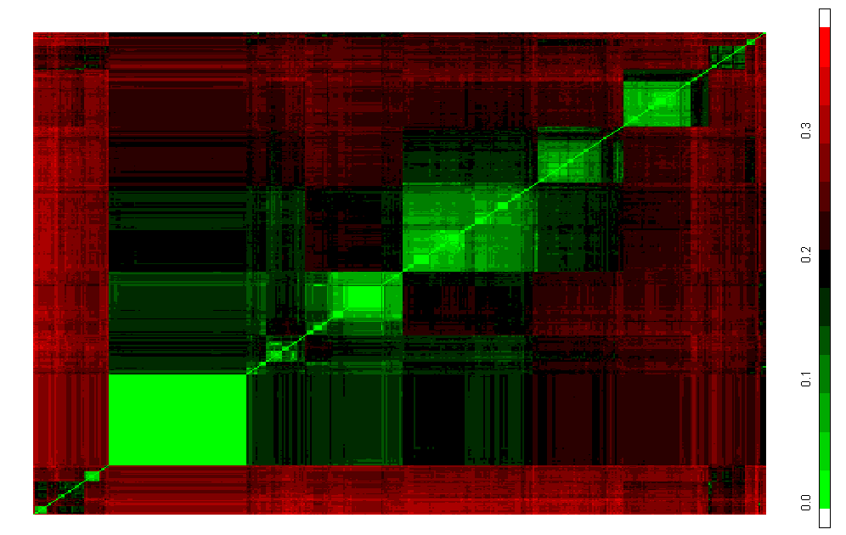
Taxonomic structure of the Verrucomicrobia revealed
Unclassified
Optitutus
Verrucomicrobium
Chthoniobacter
Xiphenematobact
Verrucomicrobium
Rubritalea
Prosthecobacter
Verrucomicrobium
Akkermansia
Lentisphaera
Notes:
The taxonomic structure of the collection of sequences was revealed by application of a modified version of the SOSCC algorithm. Particularly noteworthy is the large number of virtually identical sequences derived from a single study that appear in GenBank as verrucomicrobia which this analysis shows as probably members of Akkersmania. Also, the clear separatation of Lentispharae (including Victivalis) and Optitutus from the Verrucomicrobia. These show a partial, distant relationship to a number of sequences that are currently labeled as unknown. At least three groups of putative verrucomicrobia exist.

Slide 38
How NamesforLife disambiguates biological nomenclature

Slide 39
NamesforLife
What is it?
A novel combination of “unrelated” technologies
  An ontology, metadata model, and a mapping
  An application of persistent identifiers
  A transparent information layer on the Internet
A semantic resolution service for the life sciences
What isn’t it?
A content provider (at least beyond the pilot stage)
What is the purpose?
Solve a well known problem
  Ambiguity in terminology
  Common problem
  Pervasive in life sciences
  The special case of biological nomenclature
    Queries and literature searches
    Assertions, assumptions, hypotheses

Slide 40
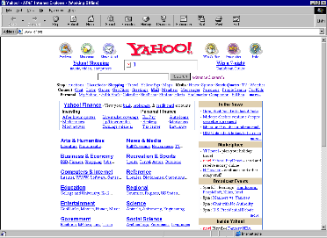


doi>
doi>
doi>
URL
DOI
URL
DOI
Assigner
URL
Content
DOI
DOI
DOI
URL
URL
DOI
directory
DOI
directory
DOI
directory
DOI
URL
DOI
URL
DOI
URL
URL
DOI
URL
DOI
Content
DOI
URL
DOI
URL
URL
DOI
DOI
URL
Courtesy of Norman Paskin,
International DOI Foundation

Slide 41
Why DOIs are the preferred GUID
DOIs
Digital object identifiers
Strengths - opaque, actionable, require metadata, identify an object, strong governance, widespread usage, not based on DNS, guarantee of persistence, proposed ISO standard.
Weakness - Not free
Technically robust
Proven technology
  DOIs are layered on top of CNRI’s Handle server
  Scalable
Widespread use in publishing industry (CrossRef)
  1674 publishers and 1098 libraries subscribing
  15,148 journals covered
  22,376,071 DOIs assigned
  > 11M end-user clicks in previous month (8/9/06)
Well understood technology
Strong social/legal framework to ensure persistence

Slide 42
N4L architecture
Seven first class object types
  Name, Taxon, Exemplar,
  Nomos, Practitioner, Feature, Nomenclatural Code
Taxon DOI
Name
Rank
Parent name
Parent taxon DOI
Methodology
Members
Taxon DOI Name
Taxon DOI Name
Taxon DOI Name
Taxon DOI Name
Taxon DOI Name
Taxon DOI Name
Taxon DOI Name
Taxon DOI Name
Taxon DOI Name
Taxon DOI Name
Taxon DOI Name
Taxon DOI
Name
Rank
Parent name
Parent taxon DOI
Methodology
Type exemplar DOI
Name DOI
Name
Name status
Authority
Synonyms
Taxon DOI
Exemplar DOI
Biodeposit
Feature
Biodeposit
Feature
Taxon DOI
Species name
Higher
Taxon object
Taxon object
Name object
Exemplar object

Slide 43
The prototype
DOI:10.1601/tx.0
A proof-of-principle application
  24,176 first-class objects
  Track changes in concepts over time
  Based on a nomenclatural taxonomy, but capable of supporting multiple taxonomic views and “time travel”
  Initial DOI services conform to AP 0
  Released January 17, 2006
  Japanese prototype released June 21, 2006
  Chinese version under development
  Arabic version under consideration

Slide 44
The mini-monograph
Preamble
Name/Name DOI
Name status, Authority
Synonyms/Name DOI
Member of: Parent Taxon DOI
Methodology
Type Exemplar DOI
Biodeposit+
Feature+
Paired Sequences
Genomic
Paired phenotypic data
Minimal description
GSC Core description
Images
Nontype exemplar
Biodeposit+
Feature+
Paired Sequences
Genomic
Paired phenotypic data
Minimal description
GSC Core description
Images
Reference DOIs
Taxon DOI
Name
Rank
Parent name
Parent taxon DOI
Methodology
Type exemplar DOI
Nontype exemplar DOI
IJSEM/ICSP
Taxonomic authorities
Name DOI
Name
Name status
Authority
Synonyms
Taxon DOI
BRCs & Collections
Genbank/EMBL/DDBJ
Taxonomic community
Genomics community
Instrument vendors
Database providers
Publishers
Exemplar DOI
Biodeposit
Feature
Biodeposit
Feature
Taxon DOI
Species name

Slide 45
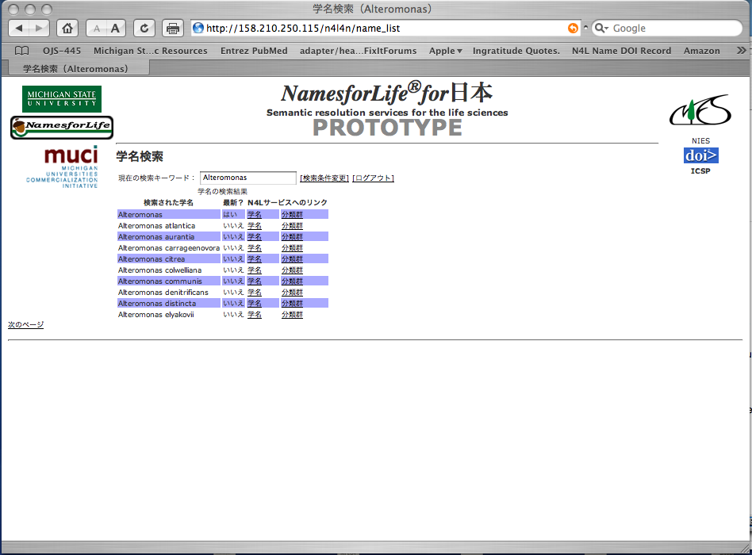
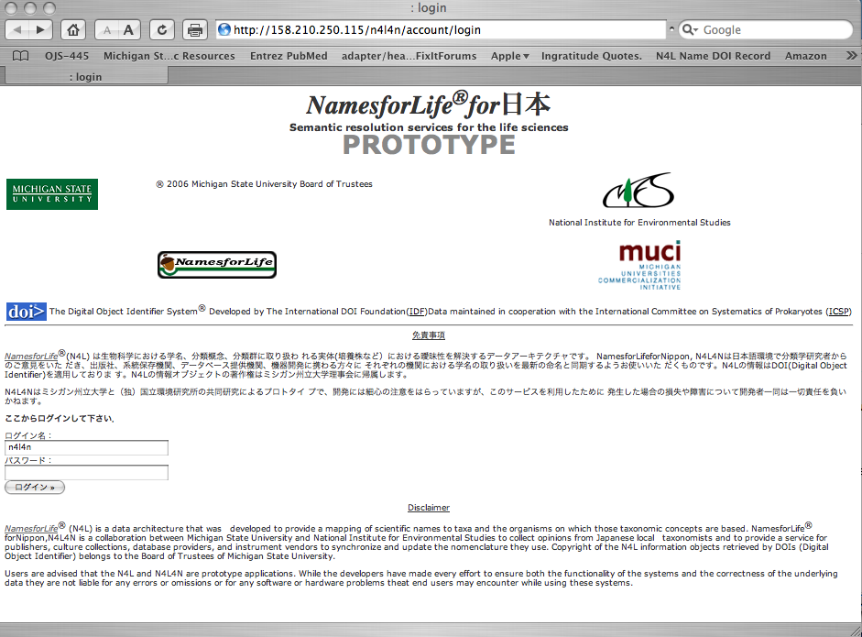
Easy support of foreign languages

Slide 46
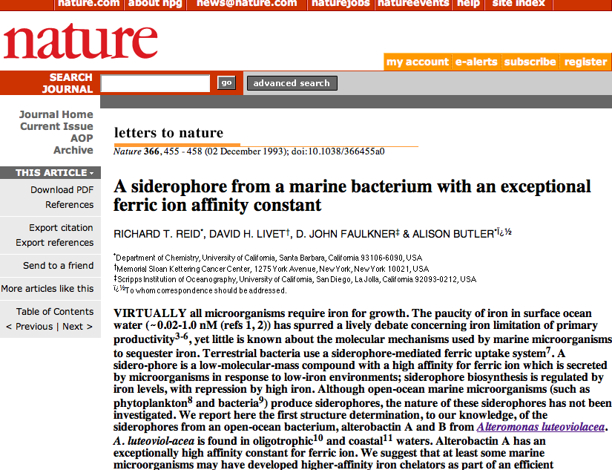

Slide 47
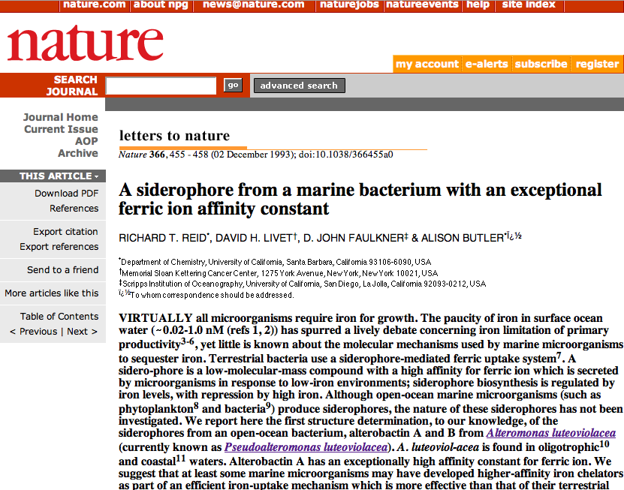

Slide 48
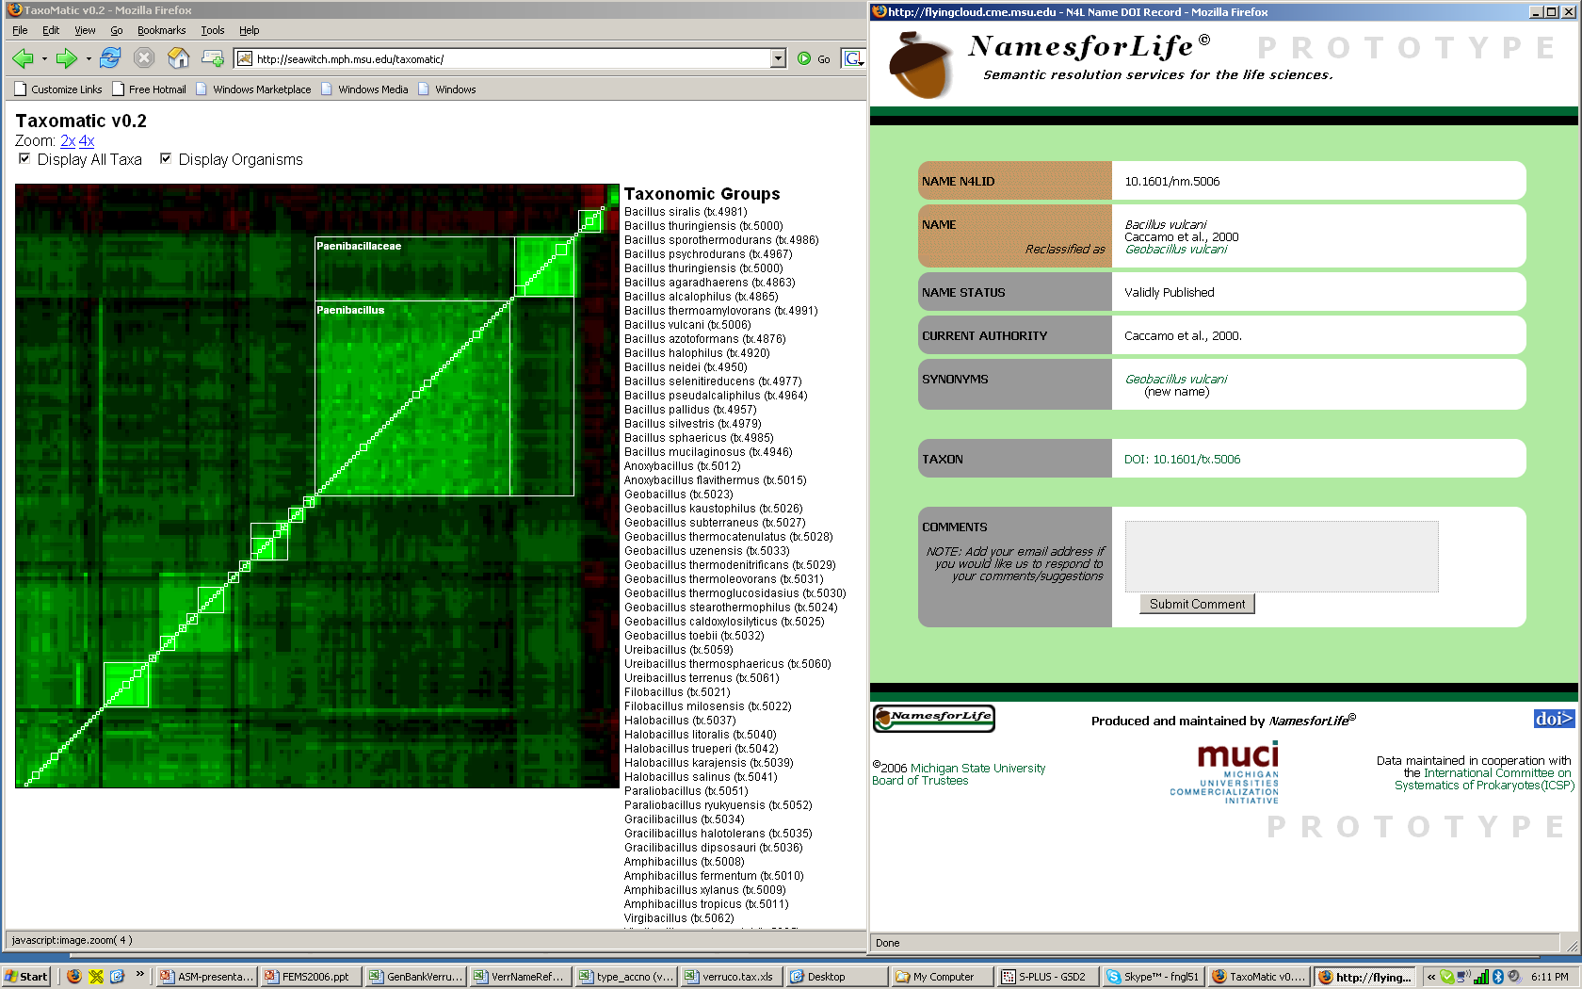
Accessing the NamesforLife information objects

Slide 49
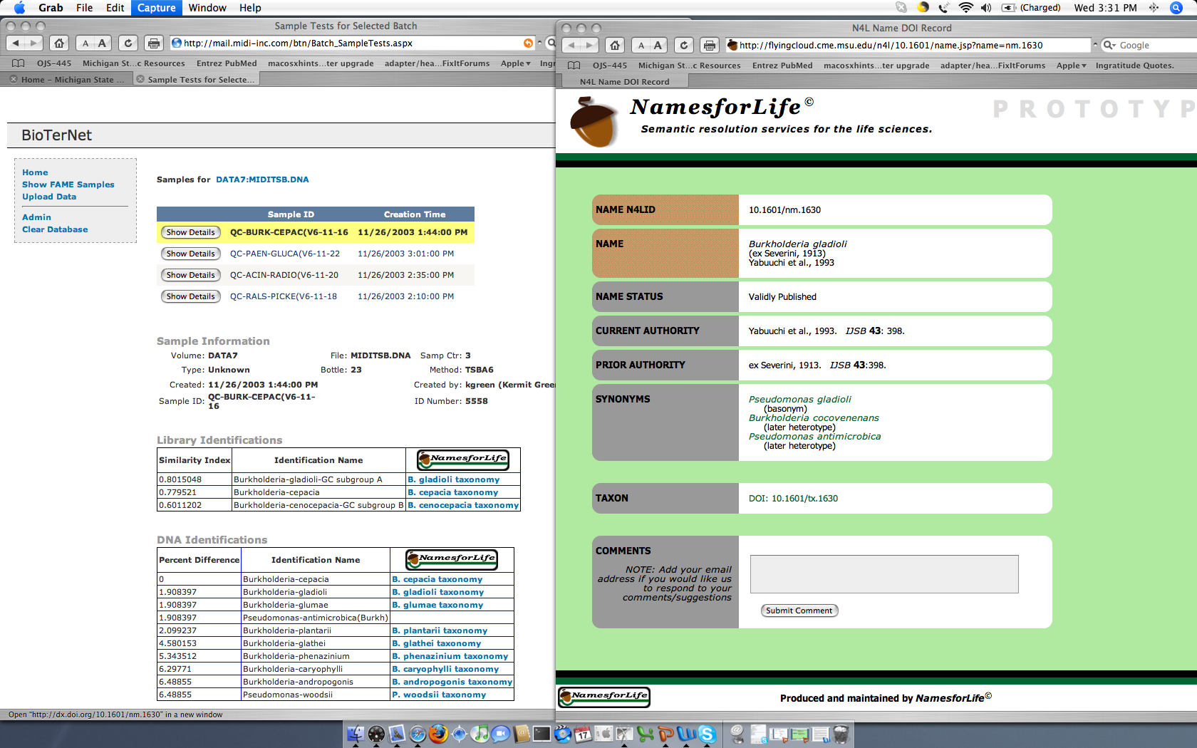
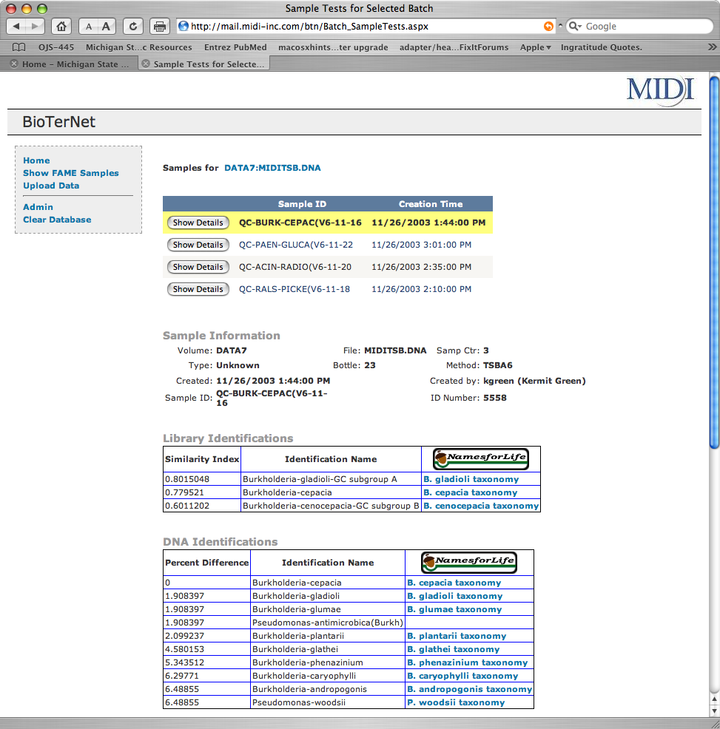
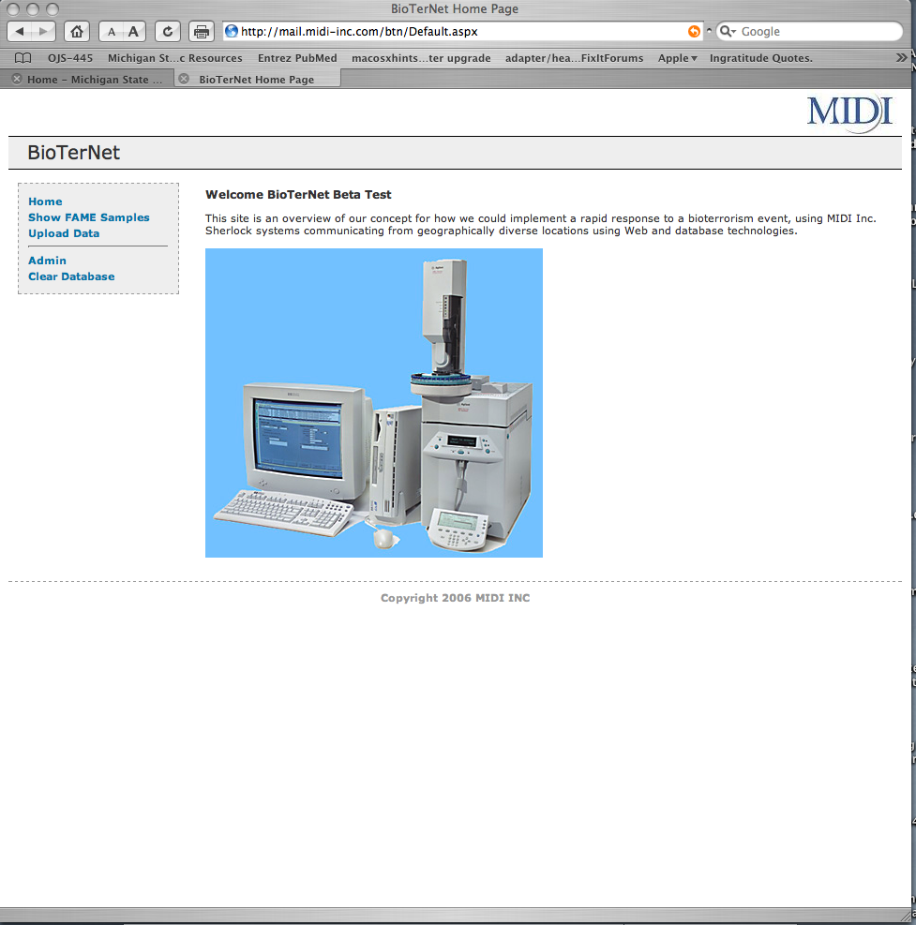
Embedding N4L links into web content

Slide 50
PhenBank…
The federated
database
Associate phenotypic data with emerging 16S sequence data
  Potential value to the community
  Problems
    Technical
      Interoperability and data comparability
      Variable granularity
      Lack of controlled vocabulary
    Social issues of the centralized model
      Who controls access?
      Who curates?
      Who pays?
      Incentives for participants?

Slide 51
PhenBank…
A decade later
Maturation of the 16S data
Impact of emerging technologies
  Large-scale sequencing efforts
  Wealth of new tools
    Predictive models
    Ontology development
    Phenotypic arrays
  Rapid emergence of web technologies
    Impact on traditional publishing
    XML, DOIs
    Semantic technology
  Impact of emerging social trends
    Community annotation, social tagging
    Open access and supplementary data
    Incentives for data sharing
      Distributed model, data discovery
      “Pay-for-view” vs. regeneration

Slide 52
The Microbe Project
Source – Rick Stevens, Argonne National Laboratory and University of Chicago

Slide 53
Sequencing the type strains
Concept
Sequence all the cultivable prokaryotic type strains
  Leverage declining sequencing costs
  Drive new technologies
  Optimize the selection process
  Involve the ICSP and broader microbiological community
  Industrialize the pipeline by leveraging
  BRC capabilities/resources
    JGI for sequencing
    Laboratories for bioinformatics
    Universities and labs for modeling and analysis
End products
Sequences
Phenotypic data
Metabolic reconstructions
Metabolic models
Integrated database

Slide 54
Provide a comprehensive set of genomes
DOE mission
Applied science
  Biofuels and alternative chemical feedstocks
  Bioremediation and bioconversion of waste streams
  Source of components for synthetic biology
Basic science
  Improved understanding and management of the carbon cycle, soil and subsurface microbiology, evolutionary and ecological dynamics
  Basis for predictive modeling of phenotypes
Scope
7951 validly published, named species
178 non-cultivable/non viable types
1222 synonyms
6389 available from 16 major collections/BRCs
154 in minor collections
380 human/animal/plant pathogens
360 complete sequences (but most not from types)
996 archael & bacterial genomes in progress
~5000 prokaryotes not yet in play

Slide 55
Particulars
Proposed project
team
Coordination & Modeling - Argonne
Systematics & Diversity - MSU and ICSP
Sequencing & Assembly - JGI
Rapid annotation - Argonne/FIG/HOPE
Type material cultivation - ATCC, DSMZ, NRRL, etc
Resources
(estimate annual
cost/year x 5)
Target selection, diversity & systematics database 0.2M
Biomaterial production, phenotyping 1.0M
Sequencing 5.0M
Rapid annotation 2.0M
Reconstruction & phenotypic modeling 2.0M
Projection coordination & management 0.2M
Status
Project in development
Pilot study in ‘07
Enlisting broad community support

Slide 56
Sequencing the type strains
Year
2007
2008
2009
2010
2011
2012
2013
2014
BP per dollar
200
300
450
675
1013
1519
2278
3417
Cost/Genome*
20000
13333
8889
5926
3951
2634
1756
1171
Genomes/$5M
250
376
563
844
1266
1898
2848
4271
Cumulative genomes sequenced
250
625
1188
2031
3297
5195
8043
12314
Selection
of Targets
Type
Culture
Material
JGI
Sequencing
Rapid
Annotation
(24 Hours)
Database
Repository
Phenotype
Prediction
Model
Generation
Metabolic
Reconstruction
Source – Rick Stevens, Argonne National Laboratory and University of Chicago

Slide 57
Thanks to
MSU
Julia Bell
Scott Harrison
Judy Leventhal
Donna McGarrell
Siddique Mohideen
Qiong Wang
Univ. Michigan
Paul Saxman
Forsyth Inst.
Floyd Dewhirst
Midi Inc.
Myron Sasser
Gary Jackoway
ATCC
Tim Lilburn
DSMZ
Brian Tindall
University of Toulouse
Jean Euzéby
IDF
Norman Paskin
NexusTechVentures
Todd Zahn
NIES Japan
Junko Shimura
Kaduo Hiraki
Soc. General Microbiology
Robin Dunford
Ron Fraser
Int. Com. System. Prok.
Aharon Oren
Hans Juergen Busse
IJSEM
Peter Kaempfer
Argonne National Lab
Rick Stevens
Funding
US DOE BER
NSF
Mich Univ. Comm. Init.
American Express
####-######-##003
Questions?

