Slide 1



Some thoughts and observations on ”Taxon Calling”
NamesforLife
NamesforLife
Bringing meaning to life ...
Bringing meaning to life ...
George M. Garrity, Phan Chuong Vo, Daniel Bakoz, and Charles T. Parker
Department of Microbiology and Molecular Genetics, Michigan State University, East Lansing, MI USA
NamesforLife, LLC, East Lansing, MI USA
http://namesforlife.com
All rights reserved.
http://namesforlife.com
All rights reserved.

Slide 2

http://ww.simbhq.org
Notes:
Need to discuss a comparison of our mission and meeitng with the KMB, which we consider a sister society. Important comparison will be the number of presentations about microbiomes.

Slide 3
Biocatalysis
Biomaterials
Environmental Microbiology
Food microbiology
Synthetic Biology
Host Pathogen Interactions
Analytical Microbiology/Testing
Biocatalysis
Biomaterials/Bioenergy
Environmental Microbiology
Metabolic Engineering
Natural Product Screening
Synthetic Microbiology
Fermentation
Microbiomes
http://ww.simbhq.org
Notes:
Need to discuss a comparison of our mission and meeitng with the KMB, which we consider a sister society. Important comparison will be the number of presentations about microbiomes.

Slide 4






Microbial Control
http://ww.simbhq.org
Notes:
Need to discuss a comparison of our mission and meeitng with the KMB, which we consider a sister society. Important comparison will be the number of presentations about microbiomes.

Slide 5



NamesforLife
NamesforLife
Bringing meaning to life ...
Bringing meaning to life ...
NamesforLife
Bringing meaning to life ...
A Michigan State University spin-off company.
A team of software developers, knowledge engineers and domain experts with a proven R&D record.
Principle goal is to apply a novel semantic technology to solve real problems in scholarly publishing.
A provider of standards compliant custom data products/services
http://namesforlife.com
All rights reserved.
http://namesforlife.com
All rights reserved.

Slide 6
NamesforLife
NamesforLife
Bringing meaning to life ...
Bringing meaning to life ...
N4L::Scribe – parsing, semantic tagging, content aggregation, resource summarization, XML validation.
N4L::Guide – browser independent rich content layer over published content in HTML form
N4L::Recommendations – rapidly identify and invite credible authors as peer-reviewers
Terminology/taxonomy development services, back content annotation
HiddenMetrixTM – semiotic indexing, search and retrieval of topically relevant content and practitioners.
http://namesforlife.com
All rights reserved.
http://namesforlife.com
All rights reserved.
Notes:
Key points to mention are externally managed resources, linked to content via actionable globally unique persistent identifiers

Slide 7
NamesforLife
NamesforLife
Bringing meaning to life ...
Bringing meaning to life ...
Stage
Primary/secondary references
  Historical and current STM literature
  Published monographs
  Current/earlier versions of the “Codes” and other specialized works.
  Patent literature
Resources
Aggregation
Curation
Publication
http://namesforlife.com
All rights reserved.
http://namesforlife.com
All rights reserved.

Slide 8
NamesforLife
NamesforLife
Bringing meaning to life ...
Bringing meaning to life ...
Stage
Digital resources
  GenBank/EMBL/DDBJ
  Culture collections/ Biological Resource Centers catalogues
  Specialized database
Resources
Aggregation
Curation
Publication
http://namesforlife.com
All rights reserved.
http://namesforlife.com
All rights reserved.

Slide 9
NamesforLife
NamesforLife
Bringing meaning to life ...
Bringing meaning to life ...
Stage
Daily retrieval
  Downloads of sequence data
  Downloads of relevant STM literature
Resources
Aggregation
Curation
Publication
http://namesforlife.com
All rights reserved.
http://namesforlife.com
All rights reserved.

Slide 10
NamesforLife
NamesforLife
Bringing meaning to life ...
Bringing meaning to life ...
Stage
Identify relevant resources
  Metadata, texts, taxonomic and nomenclatural events
  Automated primary screening
    Custom parsers for names, identifiers, various SLT
    Bibliographic references and citations
  Validate records for consistency
Resources
Aggregation
Curation
Publication
http://namesforlife.com
All rights reserved.
http://namesforlife.com
All rights reserved.

Slide 11
NamesforLife
NamesforLife
Bringing meaning to life ...
Bringing meaning to life ...
Stage
Queue and load into NamesforLife database
  Proprietary semantic data model*
  Queue for curation
Resources
Aggregation
Curation
Publication
http://namesforlife.com
All rights reserved.
http://namesforlife.com
All rights reserved.

Slide 12
NamesforLife
NamesforLife
Bringing meaning to life ...
Bringing meaning to life ...
Stage
Curation by subject expert
  Semi-automated validation
    Business logic and rules-based ontologies
      Flag inconsistent records (e.g., identifiers are incorrectly formatted, ambiguities, incorrect term usage)
      Verify availability of cited data/information
  Que validated records for DOI and ORCID assignment
Resources
Aggregation
Curation
Publication
http://namesforlife.com
All rights reserved.
http://namesforlife.com
All rights reserved.

Slide 13
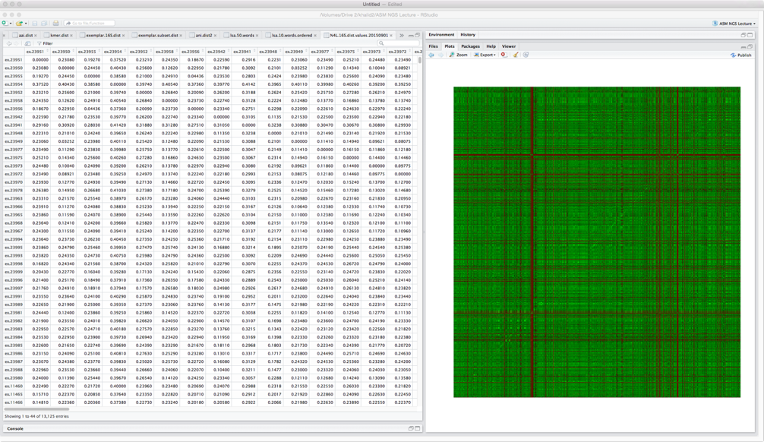
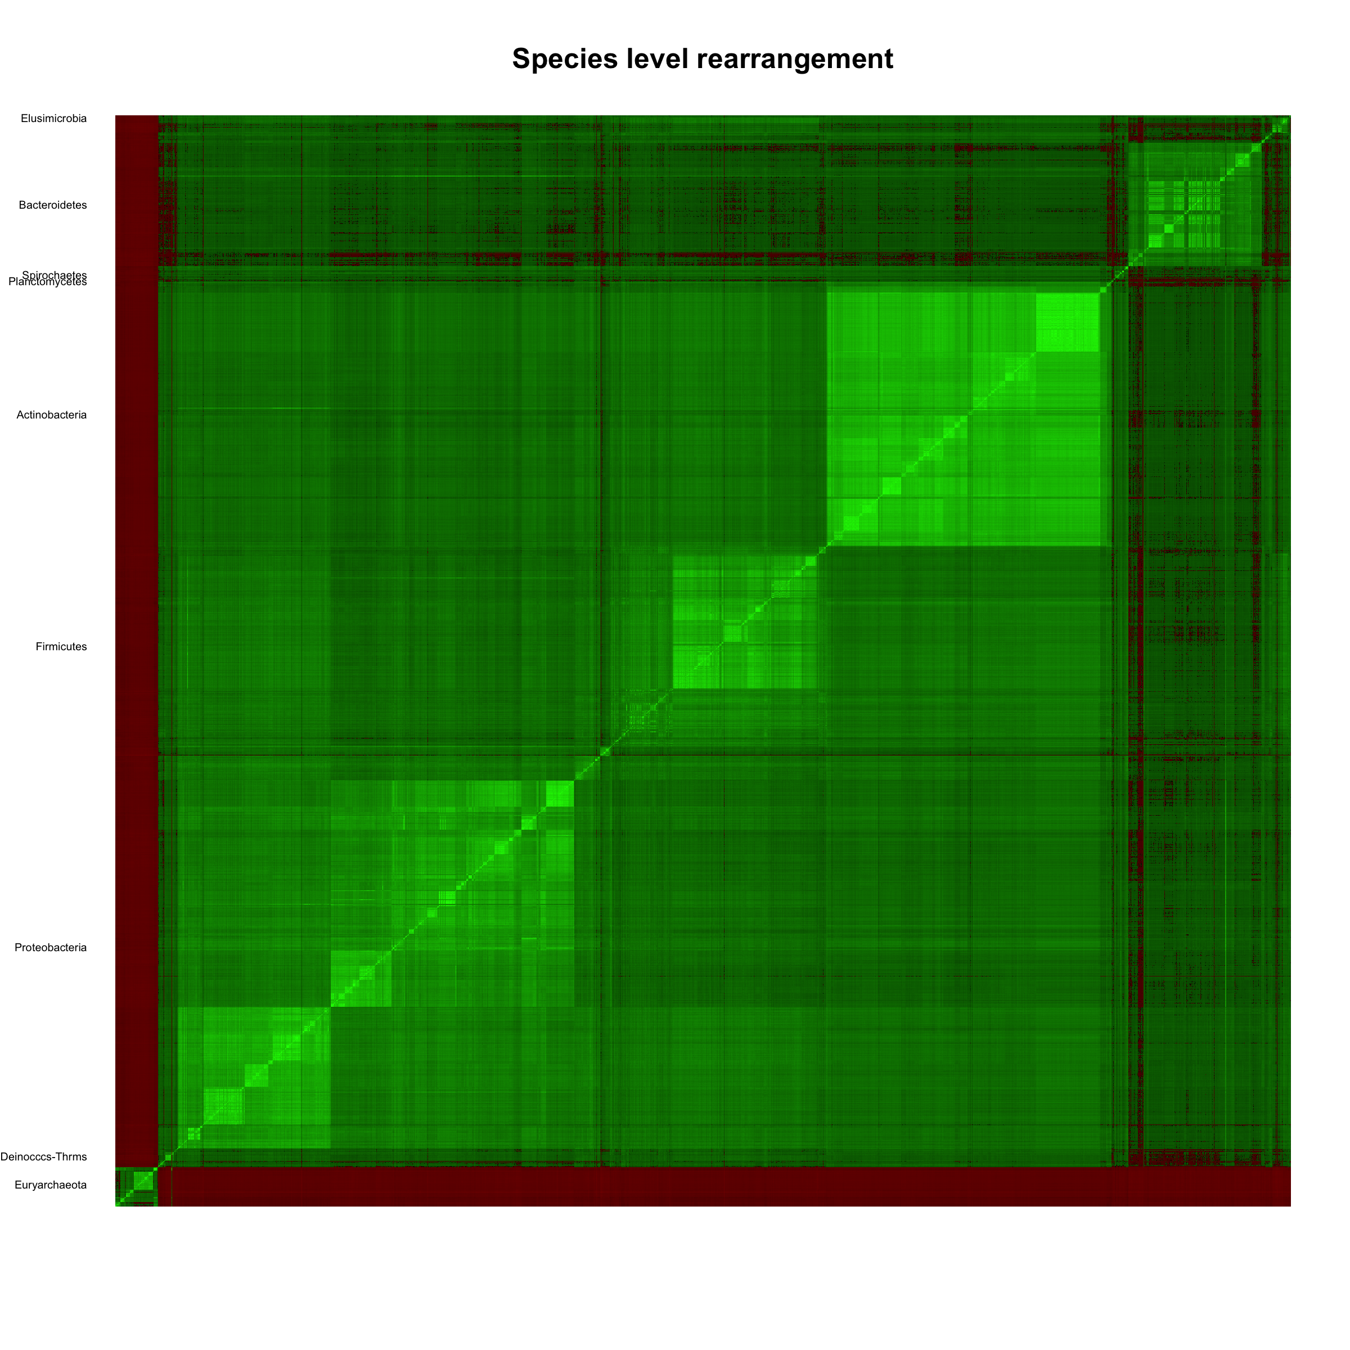
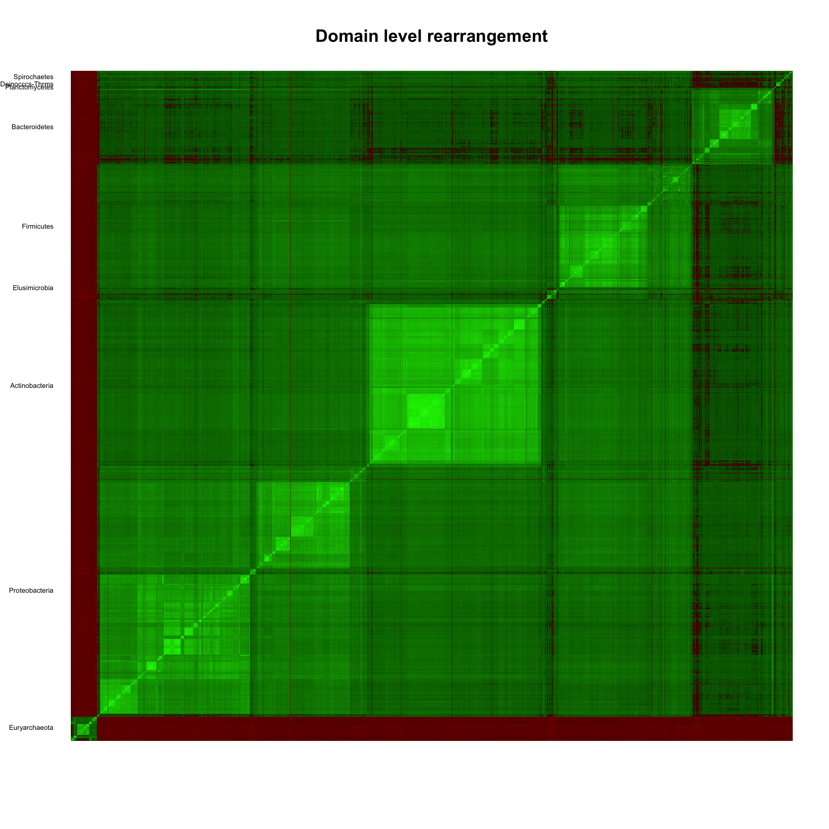
NamesforLife
NamesforLife
Bringing meaning to life ...
Bringing meaning to life ...
Stage
Sequence data
  Checked for quality, completeness and accuracy of metadata
  Proper length, strand orientation
  Chimera checked
  Kmer/alignment checked against NameforLife reference collection
  Taxonomy reviewed for completeness, correct placment
  Self-Organizing Self-Correcting Classifier
  Outliers identified/reviewed for potential reclassification
Resources
Aggregation
Curation
Publication
http://namesforlife.com
All rights reserved.
http://namesforlife.com
All rights reserved.

Slide 14
NamesforLife
NamesforLife
Bringing meaning to life ...
Bringing meaning to life ...
Stage
Publication and integration into NamesforLife and client content
  NamesforLife Abstracts
  NamesforLife Guide
  NamesforLife Scribe service
  Value added applications and data products
  Search/semantic linking
Resources
Aggregation
Curation
Publication
http://namesforlife.com
All rights reserved.
http://namesforlife.com
All rights reserved.

Slide 15
NamesforLife
NamesforLife
Bringing meaning to life ...
Bringing meaning to life ...
The NamesforLife reference taxonomy
A consensus view of the community
  Based on the published record
  Limited to the prokaryotic taxa with validly published names
  Maintained/updated daily
Represents application of commonly accepted heuristics
http://namesforlife.com
All rights reserved.
http://namesforlife.com
All rights reserved.
Notes:
Need to include a mention that names, taxonomies and phylogenies are hypotheses and the names represent a refernce to those hypothesis. Names are not facts.

Slide 16
NamesforLife
NamesforLife
Bringing meaning to life ...
Bringing meaning to life ...
Rank | Validly Published | Coverage (16S) | Genome Assemblies | Singletons | 2-3 members | 4-9 members | ≥ 10 members
Species | 13,955 | 13,733 | 5636 | 13,955 | 0 | 0 | 0
Genera | 2,755 | 2,707 | 1692 | 1305 | 697 | 445 | 257
Families | 513 | 507 | 415 | 141 | 83 | 90 | 193
Orders | 225 | 224 | 190 | 65 | 32 | 31 | 96
Classes | 90 | 90 | 81 | 26 | 11 | 12 | 41
Phyla* | 34 | 34 | 34 | 5 | 4 | 4 | 21
Domains* | 2 | 2 | 2 | 0 | 0 | 0 | 2
Source - NamesforLife, LLC, based on validly published named prokaryotic species, subspecies and higher taxa as of May 21, 2017; adjusted for synonyms, basonyms, orthographic corrections and rejected names arising from Judicial Opinions.
http://namesforlife.com
All rights reserved.
http://namesforlife.com
All rights reserved.

Slide 17
NamesforLife
NamesforLife
Bringing meaning to life ...
Bringing meaning to life ...
Statement of the problem
Are current 16S metagenomic methods adequate?
  Reproducibility/reliability/interoperability
  For use in a production taxonomy
    Need to recognize analytical truth
    Taxonomic precision
PDE = |n1 = n2|/n1 + n2 * 100
    Taxonomic accuracy
PTD = [ 1 – (comp_{pos}/N)] * 100
But, what is the taxonomic truth?
http://namesforlife.com
All rights reserved.
http://namesforlife.com
All rights reserved.

Slide 18
NamesforLife
NamesforLife
Bringing meaning to life ...
Bringing meaning to life ...
T
T
T
Precise, not accurate
Precise and accurate
Not precise, not accurate
http://namesforlife.com
All rights reserved.
http://namesforlife.com
All rights reserved.

Slide 19
NamesforLife
NamesforLife
Bringing meaning to life ...
Bringing meaning to life ...
T
T
T
3% sequence similarity
1.5% sequence similarity
http://namesforlife.com
All rights reserved.
http://namesforlife.com
All rights reserved.
Notes:
The impact of changing taxonomic boundaries (sensu Yarza et al)

Slide 20
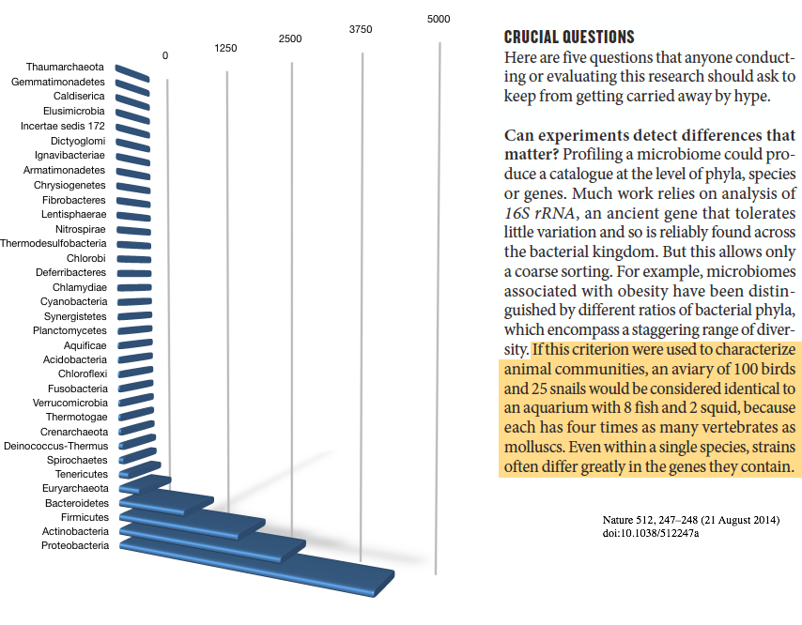
NamesforLife
NamesforLife
Bringing meaning to life ...
Bringing meaning to life ...
http://namesforlife.com
All rights reserved.
http://namesforlife.com
All rights reserved.

Slide 21
NamesforLife
NamesforLife
Bringing meaning to life ...
Bringing meaning to life ...
Hanage’s Five Questions
Can experiments detect differences that matter?
Does the study show causation or just correlation?
What is the mechanism?
How much do experiments reflect reality?
Could anything else explain the results?
http://namesforlife.com
All rights reserved.
http://namesforlife.com
All rights reserved.

Slide 22
NamesforLife
NamesforLife
Bringing meaning to life ...
Bringing meaning to life ...
High quality curated 16S sequences
Cultivated type strains (n=14,415)
Silva v119
n=141,034
Silva v123
n=155,209
Silva v128
n=172,448
Greengenes
n=202,421
NamesforLife
n=14,145
Classify Sequences
NamesforLife
SOSCC
Aligned
Mothur
Unaligned
SINTAX
Evaluate for taxonomic
consistency with names
Evaluate for correct ID
Scoring at seven levels
PDE
Under-classification
misclassification
PTD
Before and
after reannotation
Identify outliers
http://namesforlife.com
All rights reserved.
http://namesforlife.com
All rights reserved.
Notes:
Silva alignment approximately 75,000 positions
Greengenes 8500
NamesforLife 3500

Slide 23
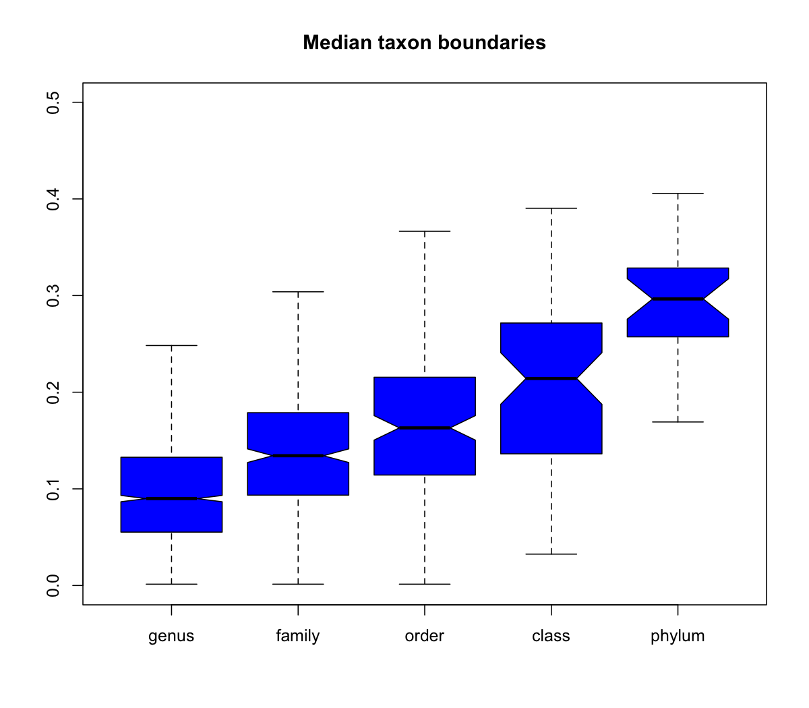
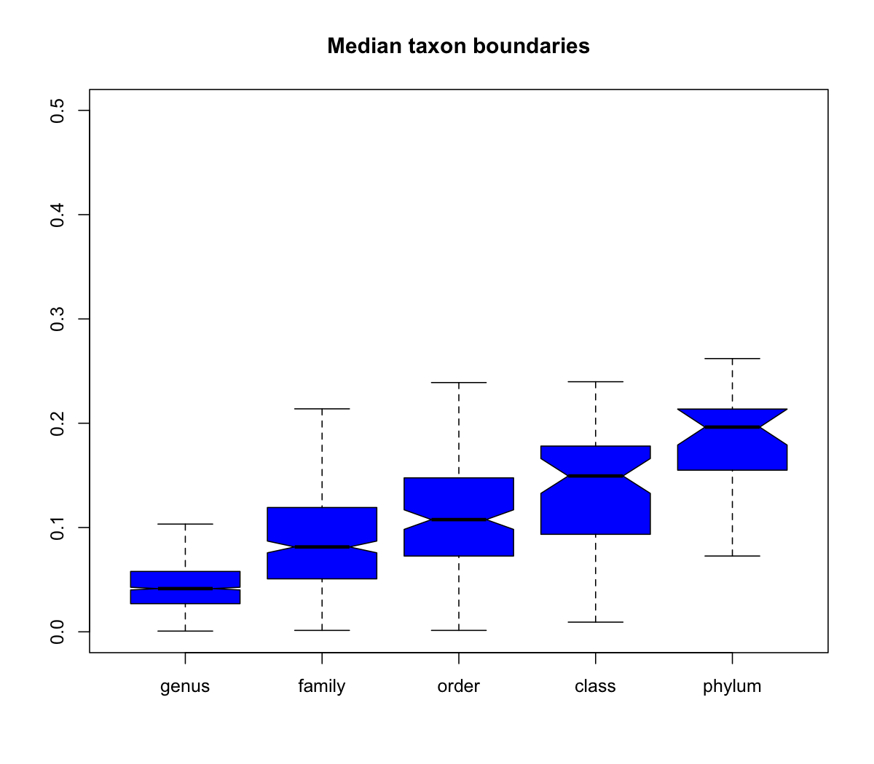
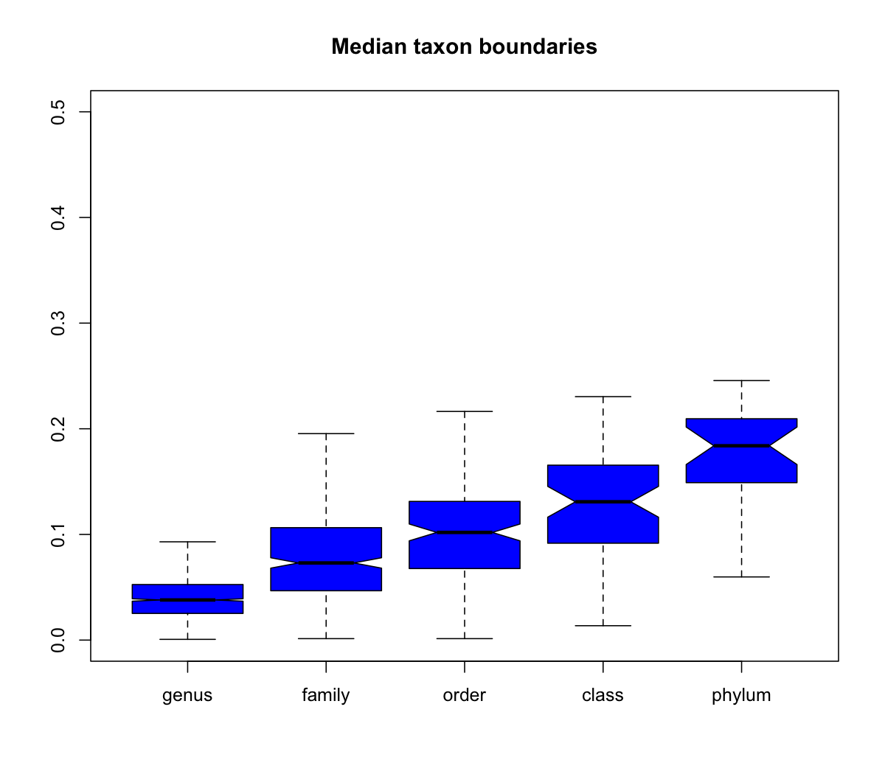
NamesforLife
NamesforLife
Bringing meaning to life ...
Bringing meaning to life ...
Some interesting and counter-intuitive results
SOSCC – Outliers (121 in common)
 | N4L | Greengenes | Silva v128
N4L | 501/331
Greengenes | 246 | 433/124
Silva | 274 | 619 | 414/101
http://namesforlife.com
All rights reserved.
http://namesforlife.com
All rights reserved.

Slide 24
NamesforLife
NamesforLife
Bringing meaning to life ...
Bringing meaning to life ...
SINTAX guided reannotation
 |  | Domain | Phylum | Class | Order | Family | Genus | Species
Silva 128 | source | 172448 | 165579 | 156031 | 143948 | 127405 | 99401
 | PTD | 0.00% | 3.98% | 9.52% | 16.53% | 26.12% | 42.36%
 | reannotated | 172398 | 151035 | 141064 | 121511 | 108338 | 83225 | 32679
 | PTD | 0.00% | 12.40% | 18.18% | 29.52% | 37.16% | 51.73% | 81.05%
Greengenes | source | 202421 | 195837 | 156905 | 162262 | 134520 | 84345 | 18179
 | PTD | 0.00% | 3.30% | 22.51% | 19.92% | 33.70% | 58.41% | 91.02%
 | reannotated | 202364 | 176629 | 164053 | 136538 | 113816 | 87816 | 36292
 | PTD | 0.03% | 12.74% | 18.95% | 32.55% | 43.77% | 56.62% | 82.07%
http://namesforlife.com
All rights reserved.
http://namesforlife.com
All rights reserved.

Slide 25
NamesforLife
NamesforLife
Bringing meaning to life ...
Bringing meaning to life ...
Taxonomic precision (best match to template)
 | Silva.v128 | Silva.v123 | Silva.v119 | Greengenes | N4L
Unique sequences | 12,619 | 12,262 | 11,928 | 11,388 | 14,145
PDE | 5.70% | 7.13% | 8.50% | 10.80% | 0.00%
Replicates | 1,230 | 1,461 | 1,692 | 1,721 | 0
Range | 1 - 9 | 1 - 9 | 1 - 9 | 1 – 53 | 1
http://namesforlife.com
All rights reserved.
http://namesforlife.com
All rights reserved.
Notes:
Percent difference enumeration

Slide 26
NamesforLife
NamesforLife
Bringing meaning to life ...
Bringing meaning to life ...
A stable reference taxonomy has been developed
  Semantically disambiguated
  Deeply and persistently linked to the relevant literature, data and metadata
An new naïve alignment is underdevelopment
Comparable resolution/improved accuracy
Re-annotation of taxonomic information is feasible, allowing genomes/metagenomes to improve accuracy in downstream application. If done with N4L::DOIs, this only needs to be done once.
Further validation and testing in real-world setting is in progress.
http://namesforlife.com
All rights reserved.
http://namesforlife.com
All rights reserved.

Slide 27
NamesforLife
NamesforLife
Bringing meaning to life ...
Bringing meaning to life ...
author | names | articles | earliest | latest | duration | naming.rate | preferred | not.preferred | emended | Co-authors
Schumann P | 690 | 418 | 1992 | 2017 | 25 | 27.60 | 647 | 43 | 96 | 819
Stackebrandt E | 637 | 278 | 1980 | 2014 | 34 | 18.74 | 523 | 114 | 140 | 542
Collins MD | 455 | 262 | 1980 | 2006 | 26 | 17.50 | 374 | 81 | 14 | 372
Kämpfer P | 447 | 293 | 1995 | 2017 | 22 | 20.32 | 418 | 29 | 67 | 475
Li W-J | 337 | 267 | 2005 | 2017 | 12 | 28.08 | 314 | 23 | 28 | 453
Yokota A | 332 | 149 | 1992 | 2016 | 24 | 13.83 | 287 | 45 | 24 | 204
Rainey FA | 320 | 147 | 1992 | 2017 | 25 | 12.80 | 266 | 54 | 39 | 247
Goodfellow M | 301 | 172 | 1973 | 2017 | 44 | 6.84 | 255 | 46 | 14 | 331
Yoon J-H | 299 | 236 | 2008 | 2017 | 9 | 33.22 | 285 | 14 | 37 | 119
Vandamme P | 286 | 164 | 1990 | 2017 | 27 | 10.59 | 245 | 41 | 42 | 485
Source - NamesforLife, LLC, May 21, 2017
http://namesforlife.com
All rights reserved.
http://namesforlife.com
All rights reserved.

Slide 28




NamesforLife
NamesforLife
Bringing meaning to life ...
Bringing meaning to life ...
NamesforLife
Bringing meaning to life ...
Charles T. Parker
Vo Phan Chuong
Dorothea Taylor
Kara Manor
Sarah Wigley
Nicole Osier
Grace Rodriguez
Ron Fraser
Robin Dunford
Karen Rowlett
Sue Andrews
Rachel Walker
Nicola Wise
Leighton Chipperfield
Amber Roberts
Kevin Petersen
Nenad Krdzavac
Danny Bakoz
Khalid Sayood
Ufuk Nalbantoglu
Sam Way
INTERNATIONAL COMMITTEE ON SYSTEMATICS OF PROKARYOTES
Tim Lilburn
Brian Tindall
Aharon Oren
David Labeda
Miriam Land
David Labeda
http://namesforlife.com
All rights reserved.
http://namesforlife.com
All rights reserved.

Slide 29







NamesforLife
NamesforLife
Bringing meaning to life ...
Bringing meaning to life ...
Oranmiyan Nelson
Editorial Board
Dave Ussery
Se-Ran Jun
intewat Nookaew
Visanu Wanchai
Nikos Kyrpides
Neha Varghese
Gerry Roston
Kurt Riegger
Ed Pence
Norman Paskin
This work was funded through the Small Business technology transfer program of the United States Department of Energy under grants number DE-FG02-07ER86321 and DE-SC0006191. Funding for business development was provided through grants and loans from the Michigan Economic Development Corporation and the Michigan Universities Commercialization Initiative. NamesforLife semantic resolution technology is covered under US Patent 7,925,444 B2. The SOSCC systems and methods is covered under US Patent 8,036,997. Semiotic fingerprinting is covered under US 8,903,824. Semantic tagging, indexing, equivalency mapping, and latent semantic analysis of molecular sequence data are the subjects of pending US and EPO patent applications.
http://namesforlife.com
All rights reserved.
http://namesforlife.com
All rights reserved.

