Slide 1
Observations on the impact of rapid changes in prokaryotic taxonomies and nomenclature
George M. Garrity, Sc.D.
Department of Microbiology and Molecular Genetics
Michigan State University
NamesforLife, LLC
East Lansing, Michigan USA

Slide 2
Names, labels and nomenclature
Why we name things
What are the differences?
Names give meaning but may or may not be unique, persistent
Labels often not overlap with names and may be follow a numbering scheme
Nomenclatures are formal naming systems for specific entities that are governed by rules and provide definitions that can be referenced
Notes:
There are significant differences between names, labels and formal nomenclature systems
Rationale for naming things (a mnemonic)
communicate information (e.g., distinguishing properties) about concrete or abstract entities or concepts
Names
often convey some additional information about the named entities
may/may not be unique
may/may not be persistent
may/may convey meaning
Labels
often overlap with names but tend to be trivial/vernacular
may/may not follow some sort of number schema
Nomenclature
formal system of naming members of a particular set of entities with common properties
typically governed by a set of rules or principles
formation/application
provide a set of referenceable definitions used to characterize and differentiate named entities

Slide 3
Taxonomies
Knowledge representation
Usually hierarchical
Heuristics for ordering used to ensure interoperability
Not regulated for plants, animals, algae, fungi protists or prokaryotes. Regulated for viruses
Key concepts are ranks, types and priority
Notes:
Knowledge representation
parent child relationships
holonyms/meronyms
Set of “rules”/principles/heuristics for ordering a collection of entities into a hierarchy/network or other structure that can be accessed and used in building predictive models (aka interoperability) - Important to point out that not regulated in biology
For prokaryotes, the current scheme is:
Ranks
Domain <- Phylum <- Class <- Order <- Family <- Genus <- Species <-Subspecies
Intervening sub ranks are occasionally used
Only the ranks of Subspecies to Class are currently recognized within the formal nomenclature, although phyla and domains are widely recognized and used
Only species and subspecies are true terminal entities and represented by biological entities (strains)
Ranks of Genus to domain are aggregates of lower taxa
Typological concept
Each formally named biological entity is represented by a “type”
species/subspecies are represented by type strains
genera are represented by type species
families and orders are represented by type genera
classes are represented by type orders
phyla (when formally accepted) will be represented by type classes.
Only type strains have genes/genomes/phenotypic properties
Higher taxa are, however, ultimately linked to the genes/genomes/features of a specific (designated) strain

Slide 4
Understanding the names of prokaryotes
Lactobacillus terrae Kim et al. 2018 sp. nov.
Lactobacillus Beijerinck 1901 (Approved Lists 1980) emend. Cai et al. 2012
Lactobacillus halotolerans (ex Reuter 1970) Kandler et al. 1983 →
Weissella halotolerans (Kandler et al. 1983) Collins et al. 1994
Lactobacillus kefir (sic) Kandler and Kunath 1983
Lactobacillus kefiri corrig. Kandler and Kunath 1983
Lactobacillus kimchii Yoon et al. 2000 pro synon. Lactobacillus paralimentarius Cai et al. 1999
Lactobacillaceae Winslow et al. 1917 (Approved Lists 1980)
Lactobacillales Ludwig et al. 2010
Bacilli Ludwig et al. 2010
Firmicutes (sic) Gibbons and Murray 1978 emend. Garrity and Holt 2001
Bacillota corrig. Gibbons and Murray 1978 emend. Garrity and Holt 2001
Notes:
Need to touch on the exemplar (type strain) and how it differs between homotypic and heterotypic synonyms

Slide 5
Some important resources

Slide 6
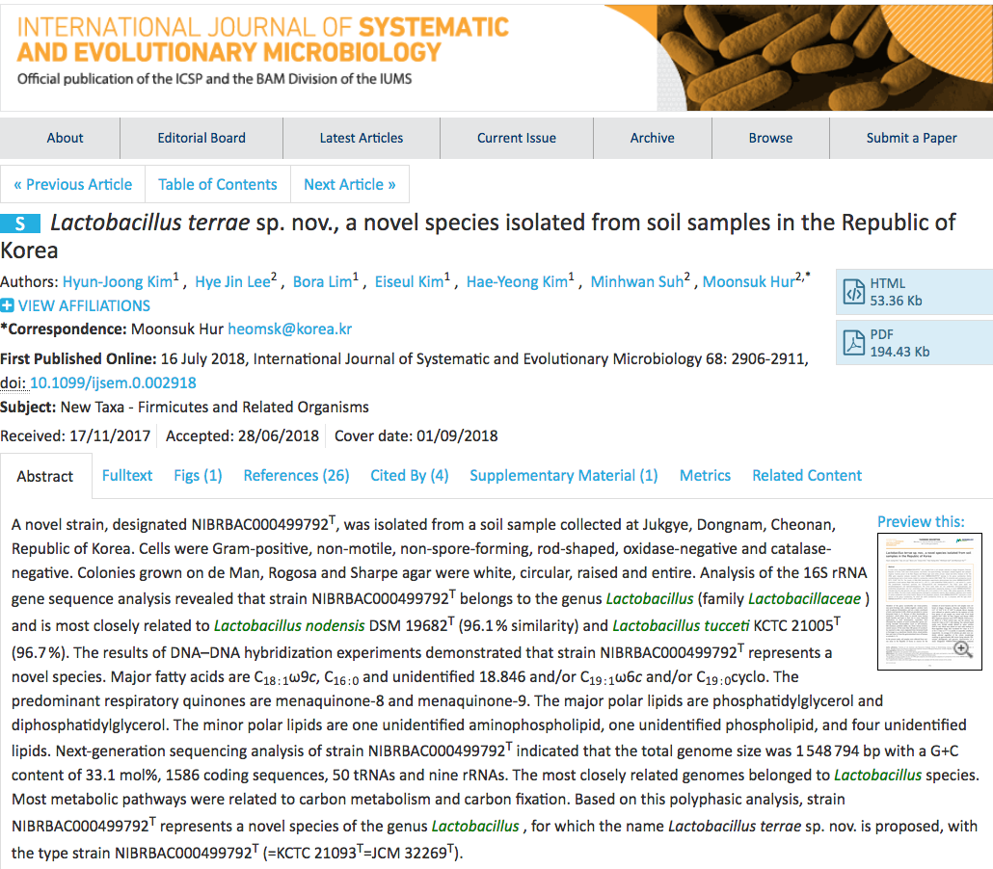
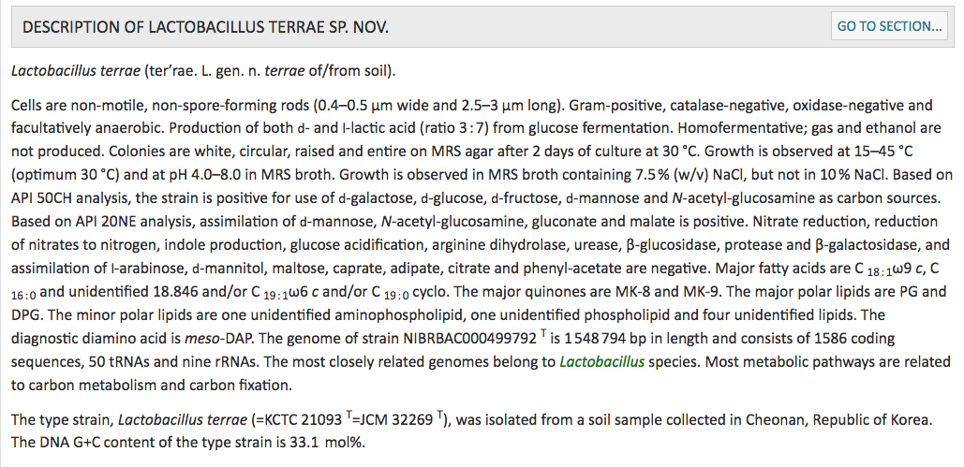

Slide 8
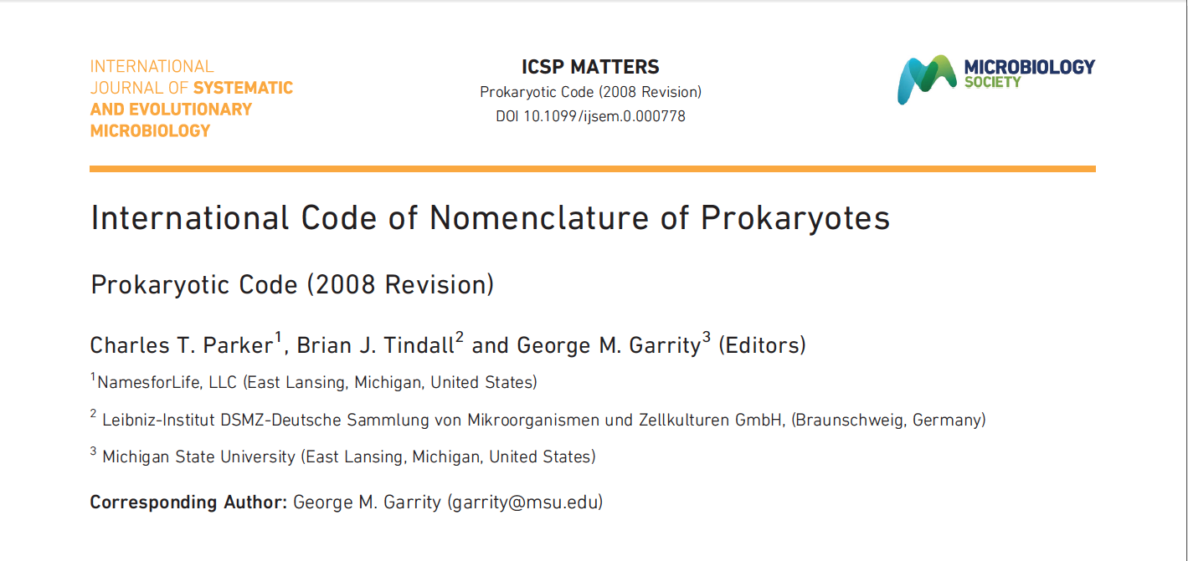
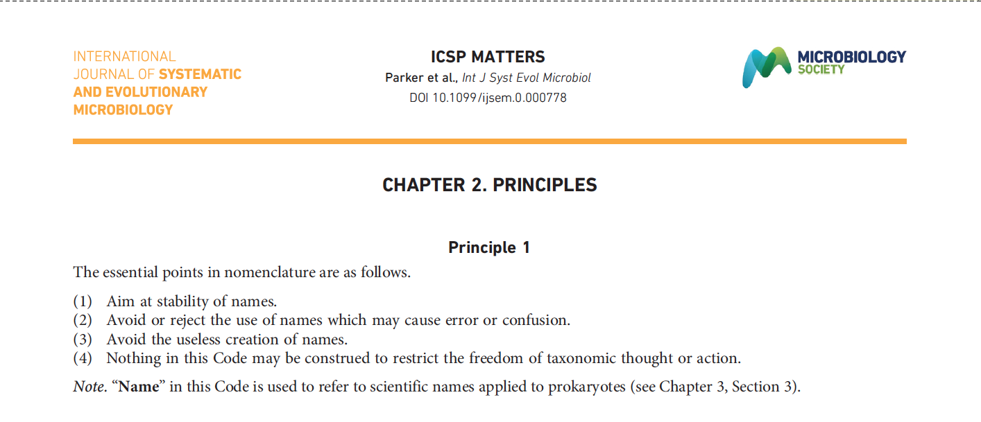
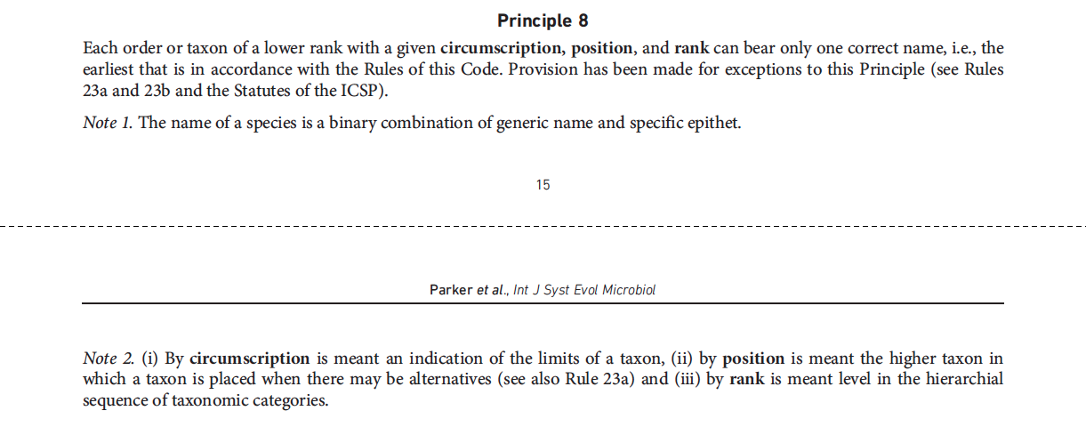

Slide 9
Why is nomenclature so hard to use and understand?

Slide 10
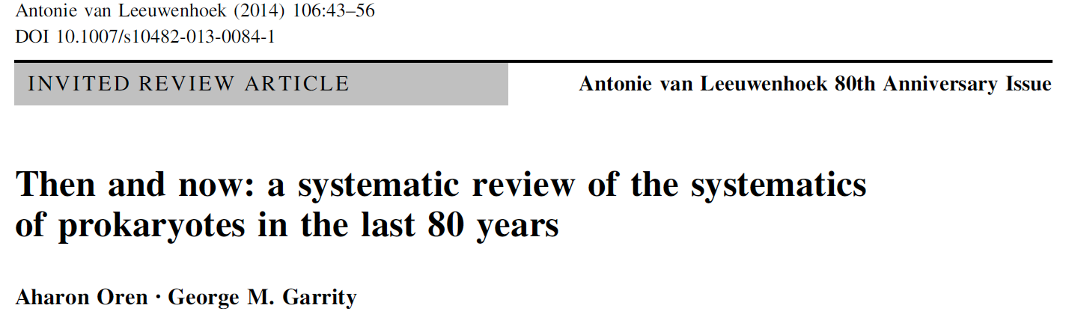
Notes:
A case in point was described a few years ago by Oren and Garrity which provided a comparative view of the taxonomy of prokaryotes in 1934 and 2013. Following a massive purge of ambiguous names in the creation of the Approved Lists (1980), only 2200 names were deemed sufficiently well defined to warrant continued usage. Subsequently, over 15,000 new names were validly published in conformance with the 1976 Code of Bacterial (Prokaryotic) nomenclature and subsequent revisions.
The relevance of all of these changes to culture collections and the broader community should be obvious.

Slide 11
Solving the problems of ambiguous names

Slide 12
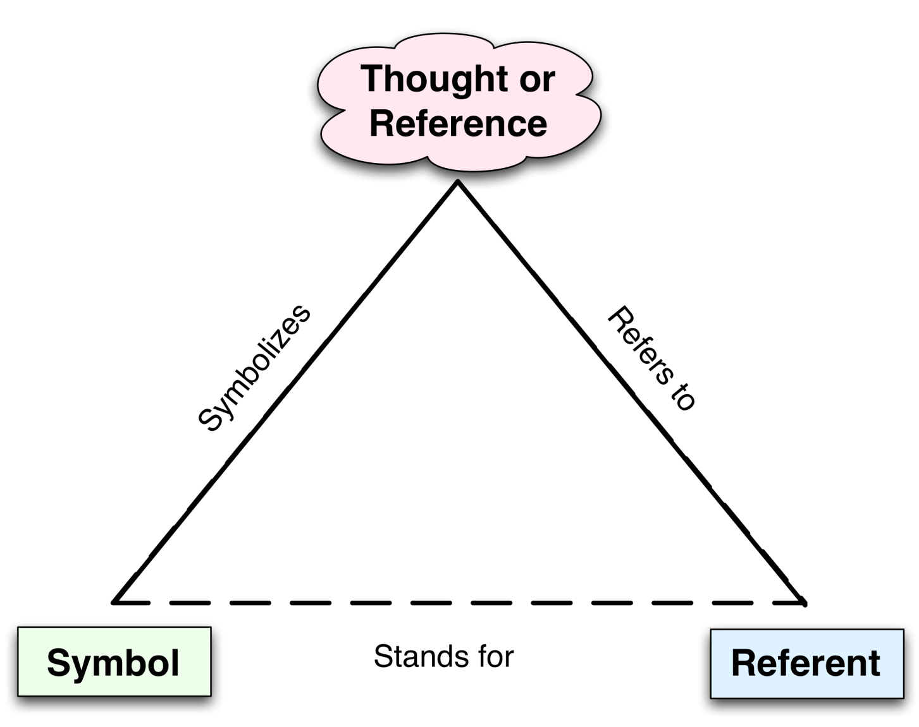
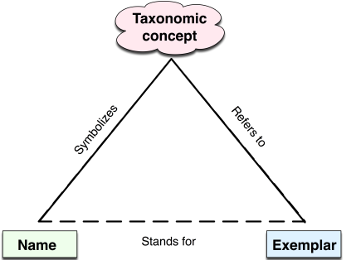
The NamesforLife Data Model
Rooted in semiotic theory
The relationship between signs, objects and their meaning
Explains source of ambiguity, but does not resolve ambiguity
Models the relationship between names, taxa and biological entities (exemplars) at the species/subspecies level

Slide 13
The NamesforLife Information Architecture
The NamesforLife solution
Employs redirection via actionable persistent GUIDs to resolve ambiguous terms to ensure correct contextual meaning
Extended model includes practitioners and multiple taxonomies

Slide 14
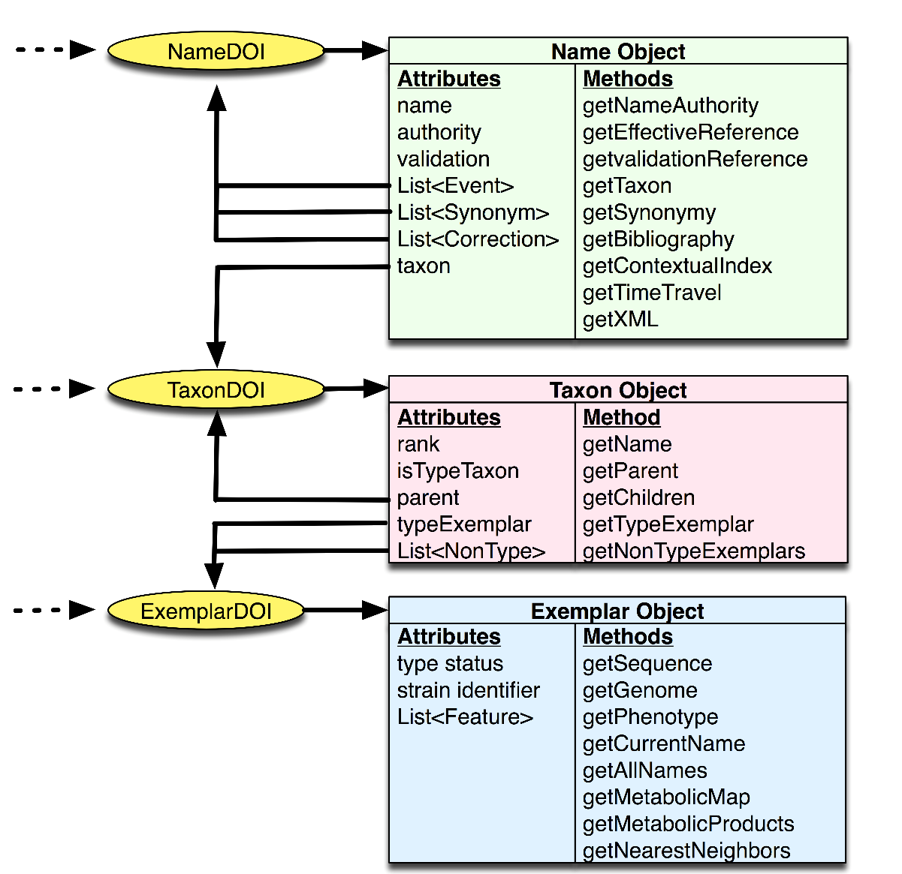
Information Objects
Dynamic taxonomies.
Driven by business logic rooted in “the Code”.
Curated resources
Associated web services
Notes:
Need to also briefly touch on synonyms and homonyms, corrections and point out that there are more names than taxa and more taxa than exemplars.

Slide 15
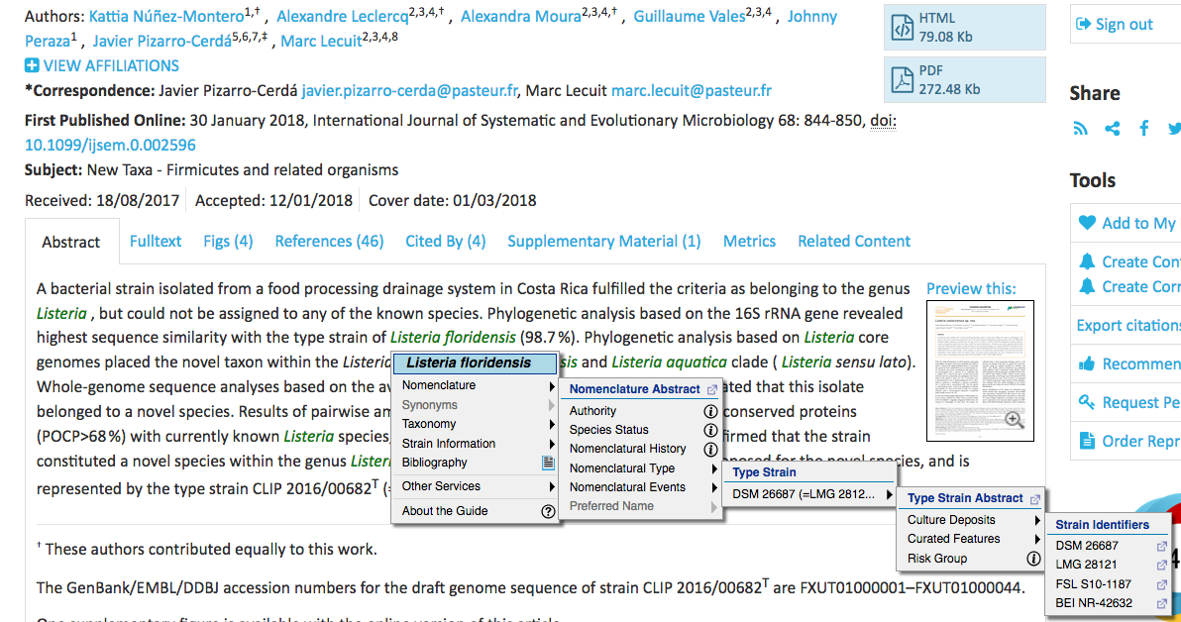
N4L::Guide: Rich Content for Readers

Slide 16
An unexpected challenge

Slide 17
It started with a simple question
Explicit changes
Implicit changes
Would re-annotation of taxonomic reference files be useful?
Notes:
Starting point with the Approved Lists on January 1, 1980.
While we discuss taxonomy (which is unregulated), we immortalize our hypotheses in the names we assign to them. These names are governed by a Code of Nomenclature, which represents an international standard to which we are supposed to adhere.
Two main types of nomenclatural events, new names/new combinations, which must be explicitly stated and published in a formalized manner and emendations of existing named taxa, which may be explicit or implicit. The vast majority are implicit, but play a significant and silent role on the evolution of any classification as they accumulate at each level, often silently.
Since 1980, there have been 22,947 validly published nomenclatural events and 198,695 emendations, almost all of which are implicit. The consequence of this is that the meaning of a name may be highly ambiguous, especially at the higher taxonomic level. So, establishing the ground truth of a name that is used may be difficult if not impossible.

Slide 18
usearch guided re-annotation of 16S rDNA reference files
Manual review of FASTA taxonomic annotations
Adjustment of taxonomic depth (seven levels)
Convert annotations to usearch format
Removal of eukaryote, plastid and cyanobacterial sequences
Reassignment of sequence identity
Classification of relabeled sequences using usearch sintax function
NamesforLife type strain database as reference (April 2018 release)
Default cutoff value (pseudo-bootstrap of 80)
Sequence identified at all seven levels – reassign
Sequence identified at 5 or six levels – reassign if mean score > 80
Sequence identified at 4 or less levels – retain original identity
Correct reassigned names
Comparison of species level identity to NamesforLife nomenclature
Results
Eliminate virtually all taxa with multiple parents found in source files
Increase number of correctly identified (high-scoring) 16S sequences
However,
None of the reference databases covered of the validly published bacteria and archaea by more than 83% at the time of the experiment.
Reannotation
Create UDB
file
Screen
contigs
Select unique sequences
Output consensus taxonomy, shared reads, otu to unique sequence mapping
Notes:
Set the stage by describing our common workflow:
Using one of several different reference files, the routine workflow is to classify unknowns using various comparative methods. The major reference files are the RDP, Greengenes and Silva (various versions). These are also used in the popular software used in metagenome/microbiome analyses (mothur, qiime and usearch).
The question sought to address is whether or not re-annotating these resources would yield improved or taxonomically more meaningful results.

Slide 19
Results of re-annotation of 16S rDNA reference files

Slide 20
Using the revised reference files

Slide 21
The microbiome experiment
Hypothesis – are .OTU – OTU and .OTU – taxon name consistent and meaningful when different reference taxonomies are applied?
Input data
eight diverse Illumina 16S (v4) metagenome samples
Software,
mothur version 1.39, variation of Schloss’ MiSeq SOP
Hardware
Mac Pro 3.7 GHz Quad Core Intel Xeon E5, 32GB RAM/SSD
Reference taxonomy
NamesforLife type strain database (May 17, 2018 release)
Analysis – Principle Coordinate Analysis
Non-metric Multidimensional Scaling
Test for significance: Kolmogorov – Smirnov
Notes:
OUT – OUT – taxonomy unsupervised methods
OTU to name – taxonomy supervised
Four matched sample sets from anaerobic digesters
On matched soil sample
One biofilm
Two from fish egg surfaces

Slide 22

Assemble
contigs
Screen
contigs
Select unique sequences
Pre-process
Align
contigs
Screen
aligned
contigs
Filter
sequences
Select
unique
sequences
Pre-cluster
unique
sequences
Process
Chimera
check
Remove
bad sequences
QC
De-noise
N4L 2018, 2017, 2016, 2013, 2010, 2000, 1990, 1980, Silva v132, Silva v132 reannotated
Output consensus taxonomy, shared reads, OTU to unique sequence mapping
Classify
sequences*
External analysis
Analysis
Analysis
Notes:
Started out with approximately – 458,000 paired end reads
Reduced to 16,500 high quality unique sequences that mapped to a number OTUs
Time to produce high quality reads – approximately 15 min
Time to analyze against different taxonomies 5-7 min/run

Slide 23
Cumulative taxonomic abundance, combined metagenome samples compared using four taxonomies
Notes:
One of the most common first steps in the analysis of metagenome/microbiome data is a rarefaction analysis, comparing the species (or OTU abundances). But the what if the OTUna is not equal to OTUnb? Likewise, what if the way that OTUs are created are a unique to a particular experiment? We looked at rank abundance of named species in our combined metagenome samples, using four different taxonomies, the May 2018 NameforLife and May 2017 NamesforLife taxonomy, the re-annotated, corrected version of the Siva v132 seed database and the uncorrected, original seed data set. As you can see, there are stark differences among these, suggesting that any interpretation of the data would be completely dependent on the input taxonomy and an apriori knowledge of its composition. Also, it is important to point out when examining the mapping of sequences to OTUs that these differ in composition, even when a two taxonomies may be reasonably similar.

Slide 24
Bray-Curtis distance, 2018 vs 2017 taxonomy, UPGMA, bootstrapped 500 iterations
Notes:
With Terry Marsh, we also looked at the data using some additional routine analytical approaches, What proved interesting is that two time samples of the NamesforLife taxonomy mapped separately, in UPGMA analysis using the Bray-Curtis distance.

Slide 25
NMDS and PCoA of metagenome analysis using 2017 and 2018 taxonomies
Notes:
And in NMDS and PCoA analysis. This suggests that making direct comparisons of any data sets that may have been published needs to be approached carefully as derived values may not be directly comparable. The prudent approach may be to reanalyze the data under identical conditions, using the same reference taxonomy.

Slide 26
The Kolmogorov – Smirnov
Goodness of Fit Test
A non-parametric test of equality of:
  A continuous 1-D probability distribution with a reference distribution or
  Two empirical 1-D empirical distributions.
Notes:
In statistics, the Kolmogorov–Smirnov test (K–S test or KS test) is a nonparametric test of the equality of continuous, one-dimensional probability distributions that can be used to compare a sample with a reference probability distribution (one-sample K–S test), or to compare two samples (two-sample K–S test). It is named after Andrey Kolmogorov and Nikolai Smirnov.

Slide 27
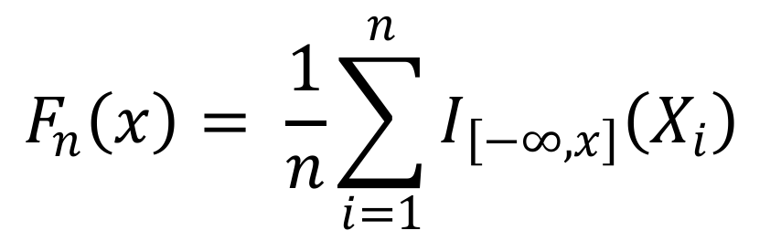
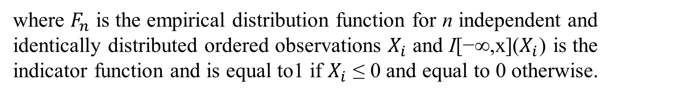
Kolmogorov – Smirnov Distribution
$$F_{n}\left(x\right)= \frac{1}{n}\sum_{i=1}^{n}{I_{\left[−∞,x\right]}\left(X_{i}\right)}$$
where $F_{n}$ is the empirical distribution function for n independent and identically distributed ordered observations $X_{i}$ and I[−∞,x]($X_{i}$) is the indicator function and is equal to1 if $X_{i}$ ≤ 0 and equal to 0 otherwise.
Notes:
The empirical distribution function F_{n} for n iid ordered observations X_{i} is defined as
Fn(x)=1n∑i=1nI[−∞,x](Xi)where I[−∞,x](Xi) is the indicator function, equal to 1 if Xi≤x and equal to 0 otherwise.
The Kolmogorov–Smirnov statistic for a given cumulative distribution function F(x) is
Dn=supx|Fn(x)−F(x)|where sup _{x} is the supremum of the set of distances. By the Glivenko–Cantelli theorem, if the sample comes from distribution F(x), then D_{n} converges to 0 almost surely in the limit when n goes to infinity. Kolmogorov strengthened this result, by effectively providing the rate of this convergence (see below). Donsker's theoremprovides yet a stronger result.
In practice, the statistic requires a relatively large number^{[clarification needed]} of data points to properly reject the null hypothesis.

Slide 28
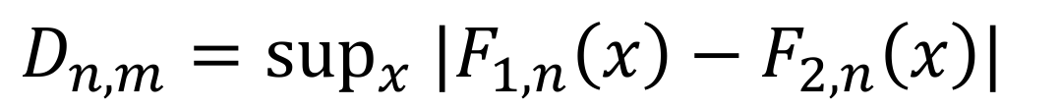
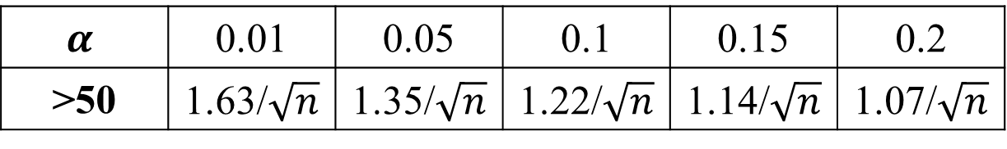
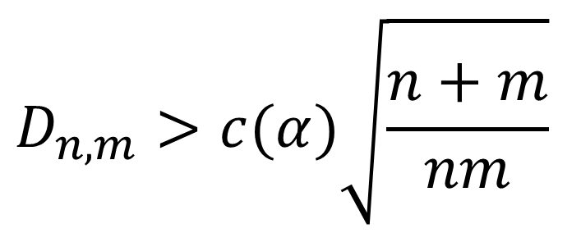
Kolmogorov-Smirnov Statistic
$$D_{n,m}=\sup_{x} |F_{1,n}\left(x\right)−F_{2,n}\left(x\right)|$$
Where sup_{x} is the supremum of the set of distances. If a sample comes from the distribution (F_{x}), D_{n} converges to 0 and n goes to infinity.
$$D_{n,m}>c(α)\sqrt{\frac{n+m}{nm}}$$
$$α$$ | 0.01 | 0.05 | 0.1 | 0.15 | 0.2
>50 | 1.63/$\sqrt{n}$ | 1.35/$\sqrt{n}$ | 1.22/$\sqrt{n}$ | 1.14/$\sqrt{n}$ | 1.07/$\sqrt{n}$
Notes:
The empirical distribution function F_{n} for n iid ordered observations X_{i} is defined as
Fn(x)=1n∑i=1nI[−∞,x](Xi)where I[−∞,x](Xi) is the indicator function, equal to 1 if Xi≤x and equal to 0 otherwise.
The Kolmogorov–Smirnov statistic for a given cumulative distribution function F(x) is
Dn=supx|Fn(x)−F(x)|where sup _{x} is the supremum of the set of distances. By the Glivenko–Cantelli theorem, if the sample comes from distribution F(x), then D_{n} converges to 0 almost surely in the limit when n goes to infinity. Kolmogorov strengthened this result, by effectively providing the rate of this convergence (see below). Donsker's theoremprovides yet a stronger result.
In practice, the statistic requires a relatively large number^{[clarification needed]} of data points to properly reject the null hypothesis.

Slide 29
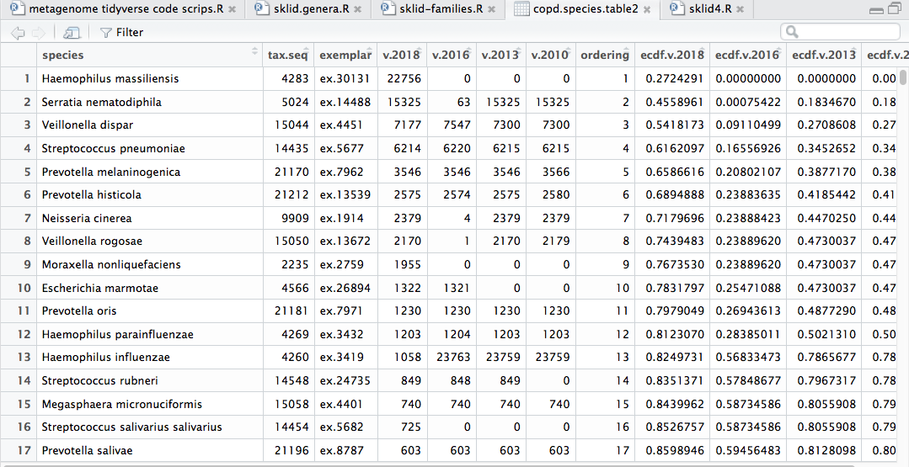

Slide 30
Cumulative taxonomic distribution
Notes:
To simplify the analysis, the ordering of the taxa in the output (the x-axis) was held constant and roughly follows the taxonomic structure of the original RDP tree and was used in structuring content in the 2nd edition of BMSB, and has been continuously updated by NamesforLife since 2004. This also allows us to immediately visualize where there are large and potentially significant differences between taxonomies over time.

Slide 31
Initial findings
Of the possible pairwise comparisons of taxonomic distributions for the amplicon metagenomics data, only two distributions were considered the same: 2018 – 2017. All others were significantly different from one another.
Comparison of samples required re-analysis with and against the same taxonomic file to ensure that any differences between samples are due to biological or environmental factors.
Results of analyses and any assertions of novel taxa or functions may not be meaningful if an out-of-date reference taxonomy is used.
Given the rate of change, taxonomic reference files more than one year old should be re-annotated prior to use.

Slide 32
The follow-on experiment
Input data
Same eight diverse Illumina 16S (v4) metagenome samples
Two additional metagenome data sets
Software,
mothur version 1.39, variation of Schloss’ MiSeq SOP
Hardware
Mac Pro 3.7 GHz Quad Core Intel Xeon E5, 32GB RAM/SSD
Reference taxonomies
NamesforLife type strain database (September 29, 2018 releases)
Analysis
Test for significance: Kolmogorov – Smirnov
Monthly taxonomic updates (September 2018 – August 2018)

Slide 33
Impact of taxonomic changes July 2017 – August 2018

Slide 50
Further findings and follow-up experiments
Statistically significant changes
Occurred by eight months for some test metagenomes
Multiple sources of variability
Taxonomic revisions vs. shifts
Impact of changes to taxonomic input
Additional sequences identified
Follow-on experiments
Additional metagenome samples
mothur vs. QIIME vs. usearch/uparse pipelines
Full-length vs. short reads
Mapping to N4L exemplars vs. names
Publications
First draft by mid-late November 2018

Slide 51









NamesforLife
Bringing meaning to life ...
Roman A. Barco
Charles T. Parker
Nicole Osier
Vo Phan Chuong
Dorothea Taylor
Kara Mannor
Dave Ussery
Michael Robeson
Trudy Wassenar
Visanu Wanchai
Sarah Wigley
Grace Rodriguez
Amber Roberts
Danny Bakoz
Terry Marsh
Ashley Shade
John Guittar
Keven Petersen
Nenad Krdzavac
Nikos Kyrpides
Neha Varghese
TBK Reddy
This work was funded through the Small Business Technology Transfer program of the United States Department of Energy under grants number DE-FG02-07ER86321 and DE-SC0006191. Funding for business development was provided through grants and loans from the Michigan Economic Development Corporation and the Michigan Universities Commercialization Initiative. NamesforLife semantic resolution technology is covered under US Patent 7,925,444 B2. The SOSCC systems and methods is covered under US Patent 8,036,997. Semiotic fingerprinting is covered under US 8,903,824. Semantic tagging, indexing, equivalency mapping, and latent semantic analysis of molecular sequence data are the subjects of pending US and EPO patent applications.
Copyright ©2018 NamesforLife, LLC
All rights reserved

