Slide 1

NamesforLife DOI Services
George M. Garrity and Charles T. Parker
Michigan State University
and
NamesforLife, LLC
East Lansing, MI
https://namesforlife.com
Copyright ©2018 NamesforLife, LLC
All rights reserved

Slide 2
Findability
https://namesforlife.com
Copyright ©2018 NamesforLife, LLC
All rights reserved
Notes:
Findability – the ease of use with with information can be found (e.g., if I search on a site, how easily can I find the information that I am searching for that I assume will be on that site?). But what about related information? What about new or changed information?
Discoverability – ensures that new/modified content can be found even when users don’t know it exists.
Findability and discoverability are important because they address two distinct needs of end users searching for the content they need. A user’s informational needs are not satisfied solely through finding content that they know exists, or exclusively through discovering information that they hadn’t known about previously. A user’s goals constantly change between finding specific information and discovering new information, and any well-thought-out KM strategy needs to accommodate both.
The findability/discoverability challenge is even more critical when considering intranets, knowledge bases, and other internal content/document management systems, where users may need to wade through thousands of documents to find what they’re seeking. Below are three ways that findability and discoverability manifest in KM initiatives.

Slide 3
Findability
Discoverability
https://namesforlife.com
Copyright ©2018 NamesforLife, LLC
All rights reserved
Notes:
Findability – the ease of use with with information can be found (e.g., if I search on a site, how easily can I find the information that I am searching for that I assume will be on that site?). But what about related information? What about new or changed information?
Discoverability – ensures that new/modified content can be found even when users don’t know it exists.
Findability and discoverability are important because they address two distinct needs of end users searching for the content they need. A user’s informational needs are not satisfied solely through finding content that they know exists, or exclusively through discovering information that they hadn’t known about previously. A user’s goals constantly change between finding specific information and discovering new information, and any well-thought-out KM strategy needs to accommodate both.
The findability/discoverability challenge is even more critical when considering intranets, knowledge bases, and other internal content/document management systems, where users may need to wade through thousands of documents to find what they’re seeking. Below are three ways that findability and discoverability manifest in KM initiatives.

Slide 4
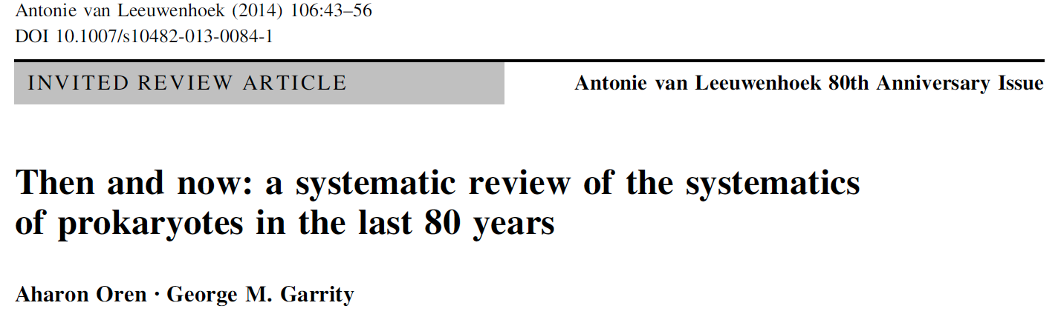
https://namesforlife.com
Copyright ©2018 NamesforLife, LLC
All rights reserved
Notes:
A case in point was described a few years ago by Oren and Garrity which provided a comparative view of the taxonomy of prokaryotes in 1934 and 2013. In the 80 years that have passed since the first issue of Antonie van Leeuwenhoek was published, the field of prokaryote systematics has changed dramatically. The 4th edition of Bergey's Manual of Determinative Bacteriology (1934) described 132 genera and 2,703 species. The numbers of genera and species with names with standing in the nomenclature in August 2013 were 2,390 and 11,482, (today 15,645 species/subspecies and 2963 genera) respectively, including no more than 75 genera and 250 species that were recognized in 1934. In the years 2006-2012, on average 624 new species were added annually, most of which were described by scientists in Asian countries. We review the past and current species concept for the prokaryotes and the current requirements for the description of new species, based on a 'polyphasic' approach. We discuss the impact of genomics and metagenomics and other new trends toward revitalization of prokaryote systematics, and provide some ideas and speculations on possible future developments in the field.
The relevance of all of these changes to culture collections and the broader community should be obvious.

Slide 5
A brief overview of NamesforLife
The problem
Ambiguity of biological nomenclature and terminology
Challenges for scientists vs. challenges for STM publishers
A novel Information Architecture
A “transparent information layer”
Tools that serve specific information to readers at the point of need
Tools to improve/automate editorial workflow
https://namesforlife.com
Copyright ©2018 NamesforLife, LLC
All rights reserved
Notes:
Want to mention that we are a member of CrossRef. Do we also want to mention that we can provide additional DOI services (e.g. registration of strains, other research artifacts as part of our services)?
Important to mention that these annotations are added to the content from externally managed

Slide 6
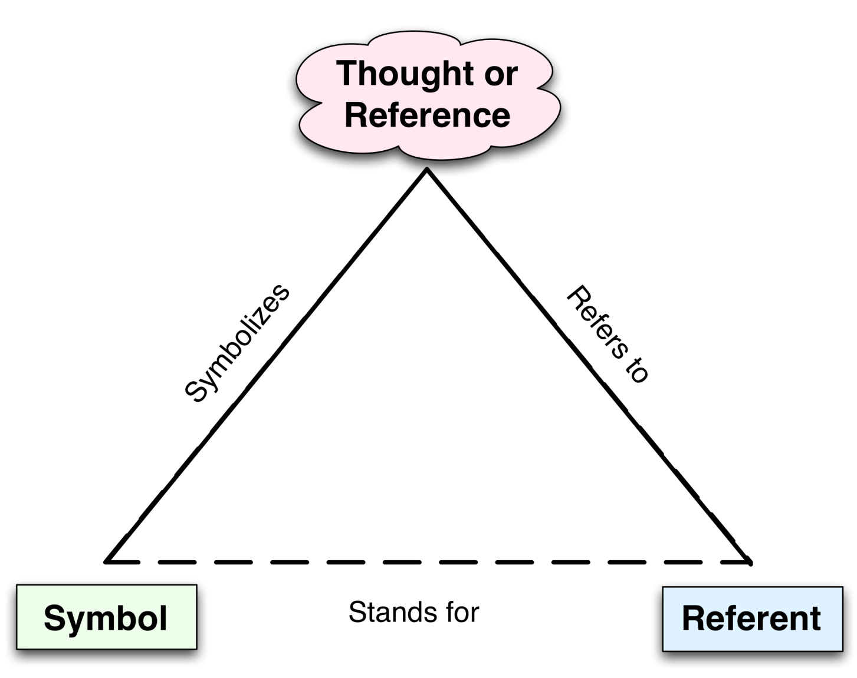
The NamesforLife Information Architecture
Rooted in semiotic theory
The relationship between signs, objects and their meaning
Explains source of ambiguity, but does not resolve ambiguity
https://namesforlife.com
Copyright ©2018 NamesforLife, LLC
All rights reserved
Notes:
On the left, I present a stylized view of Ogden and Richards concept of a semiotic triangle. What this conceptualizes is the difficulty of ensuring that the recipient of a message based on a sign, symbol (e.g., word) or utterance clearly understands what the transmitter intends. The reason is that each may hold a different concept of what a name or term applies to. The relationship between the name and concept (thought) is real, as is the relationship between the thought and named object. The relationship between the symbol and referent is imputed. Sowa uses the concept of a cat to exemplify this situation. Where “cat” invokes many different thoughts based on the who sends or receives the message.
On the right, I show how the concept of the semiotic triangle applies to biological nomenclature (or any other formalized terminology in which there is a concrete definition). Species and subspecies names are formalized and typified by tying a name to a fixed physical specimen that may either be preserved (botany and zoology) or viable. The taxonomic concept is formally defined in a circumscription that us fixed in time. As taxonomies and nomenclatures are hierarchical, taxonomic groupings (taxa) above the species levels are aggregates of concepts, so that the triangle has two concepts, one at the apex (the parent taxon) and one at the right base (the child taxon) and join together in a nested structure.
In the real world, most taxonomies are incomplete and have either one or two of the elements missing, leading to further ambiguity when names or taxonomic concepts come into usage. Taxonomic concepts are also dynamic and constantly changing, but the name only changes when a definition is emended or modified by splitting or combining together taxa. The correct name to apply in those casesis typically governed by the rule of priority, but may also be subject to other principles and rules according to the appropriate code of nomenclature.

Slide 7
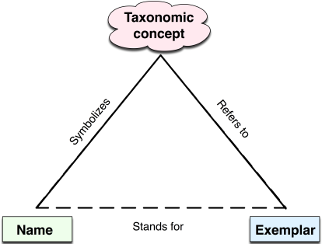
The NamesforLife Information Architecture
Rooted in semiotic theory
The relationship between signs, objects and their meaning
Explains source of ambiguity, but does not resolve ambiguity
Models the relationship between names, taxa and biological entities (exemplars) at the species/subspecies level
https://namesforlife.com
Copyright ©2018 NamesforLife, LLC
All rights reserved
Notes:
On the left, I present a stylized view of Ogden and Richards concept of a semiotic triangle. What this conceptualizes is the difficulty of ensuring that the recipient of a message based on a sign, symbol (e.g., word) or utterance clearly understands what the transmitter intends. The reason is that each may hold a different concept of what a name or term applies to. The relationship between the name and concept (thought) is real, as is the relationship between the thought and named object. The relationship between the symbol and referent is imputed. Sowa uses the concept of a cat to exemplify this situation. Where “cat” invokes many different thoughts based on the who sends or receives the message.
On the right, I show how the concept of the semiotic triangle applies to biological nomenclature (or any other formalized terminology in which there is a concrete definition). Species and subspecies names are formalized and typified by tying a name to a fixed physical specimen that may either be preserved (botany and zoology) or viable. The taxonomic concept is formally defined in a circumscription that us fixed in time. As taxonomies and nomenclatures are hierarchical, taxonomic groupings (taxa) above the species levels are aggregates of concepts, so that the triangle has two concepts, one at the apex (the parent taxon) and one at the right base (the child taxon) and join together in a nested structure.
In the real world, most taxonomies are incomplete and have either one or two of the elements missing, leading to further ambiguity when names or taxonomic concepts come into usage. Taxonomic concepts are also dynamic and constantly changing, but the name only changes when a definition is emended or modified by splitting or combining together taxa. The correct name to apply in those casesis typically governed by the rule of priority, but may also be subject to other principles and rules according to the appropriate code of nomenclature.

Slide 8
The NamesforLife Information Architecture
The NamesforLife solution
Employs redirection via actionable persistent GUIDs to resolve ambiguous terms to ensure correct contextual meaning
Extended model includes practitioners and nomoi
https://namesforlife.com
Copyright ©2018 NamesforLife, LLC
All rights reserved
Notes:
While the taxonomic triangle provide some understanding of the sources of ambiguity, it does not provide a solution. This simply cannot be accomplished using names as names have several undesirable properties that render them suboptimal as identifiers. In computing systems, good identifiers are unique (preferably globally unique), persistent, dumb, and actionable. Biological names fail on all of these conditions.
A solution to the problem was provided by Garrity and Lyons by introducing the use globally unique persistent identifiers for redirection and resolution of names, taxa and exemplars as separate first-class information objects. This allows for correct tracking and mapping of nomenclatural, taxonomic and typification in real time and has been in continuous use for approximately ten years. In the full N4L implementation, the information architecture also provides a means of assigning and tracking the creation and modification of various classes of “research artifacts” to the appropriate practitioners in the correct temporal sequence.
On a final note, by adopting digital object identifiers (an ISO standard actionable identifier that has been widely adopted by the publishing industry) as the preferred class of GUID, this ensured that our web services could be integrated into the STM literature and various databases with essentially no adverse impact on current and future work practices.
.

Slide 9
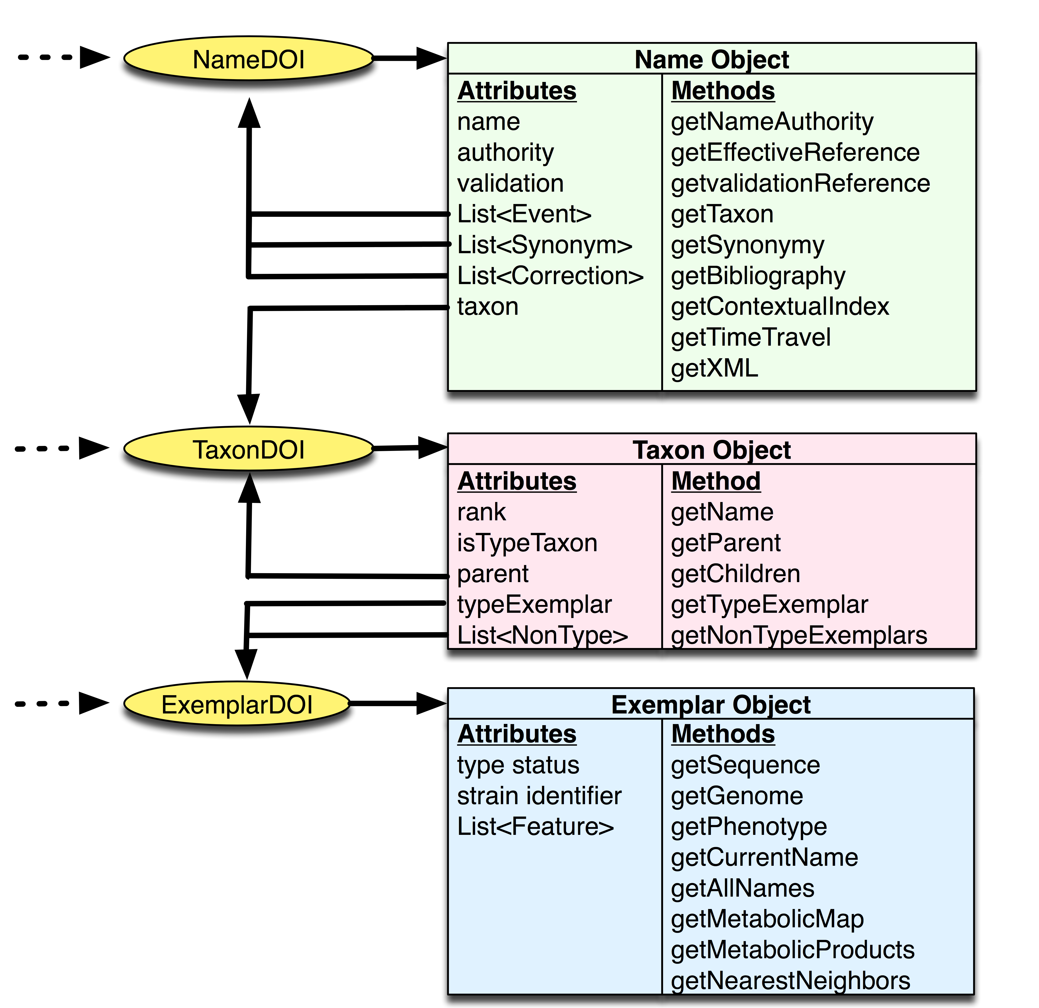
Dynamic taxonomies
Curated resources
Associated web services
https://namesforlife.com
Copyright ©2018 NamesforLife, LLC
All rights reserved
Notes:
The figure on the left shows how various N4L information objects can be joined together into a dynamic taxonomy (and multiple taxonomic views can be supported), based on tracking of the appropriate literature and “curating” the data. The lower figure shows how various web services can be developed based on each class of information object. Each specific piece of information is tied to one or more services that are accessible through one of the N4L DOIs from anywhere on the internet, based on the DOI/N\Handle protocol
This figure shows how various web services have been developed based on each class of information object. Each specific piece of information is tied to one or more services that are accessible through one of the N4L DOIs from anywhere on the internet, based on the DOI/Handle protocol

Slide 10

Offerings in the Publishing Space
N4L Guide
Rich Content Delivery Service
Published Abstracts for Microbial Taxonomy and Nomenclature
Professionally curated and linked to third-party content
N4L Scribe
Semantic Annotation and Enrichment
Manuscript Fact-checking
Manuscript Structure Checking
Expert Recommendation Service
Manuscript Fingerprinting (Hidden Metrix℠)
Document Clustering and Classification
Recommend Peer Reviewers
The core systems and methods implemented by NamesforLife are covered by US 7,925,444, US 8,036,997, US 8,903,825, US 9,659,145, US 9,672,293 and additional applications pending in six patent families.
Copyright ©2018 NamesforLife, LLC
All rights reserved

Slide 11
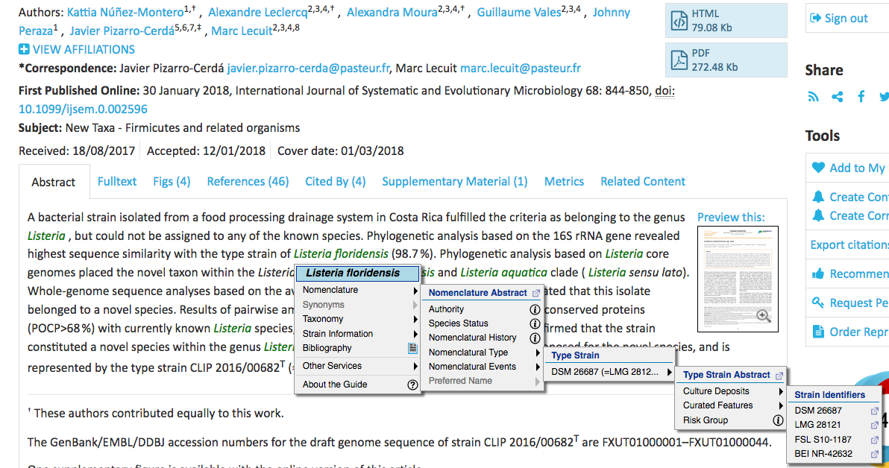
Guide: Rich Content for Readers
https://namesforlife.com
Copyright ©2018 NamesforLife, LLC
All rights reserved
Notes:
The Guide is a browser-based reader tool:
rich content over identifiers
works with content annotated by N4L::Scribe
non-intrusive to a reader
keeps a user actively engaged in an article
works on web browsers and mobile devices
zero side-effects on a web page
easily integrates into any web site
graceful service degradation
tracks topic interest

Slide 12
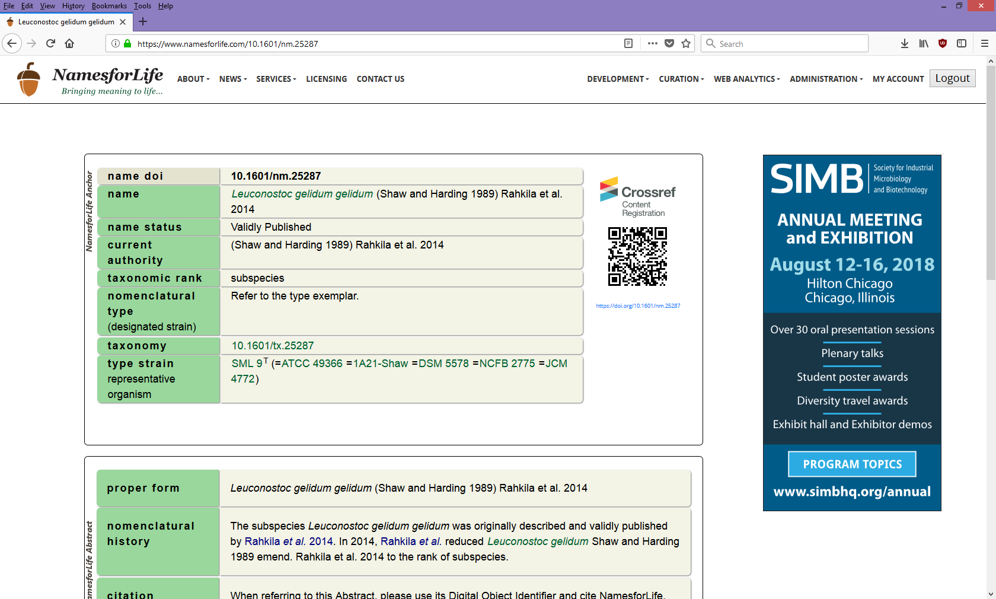

Guide: Taxonomic Abstracts
https://namesforlife.com
Copyright ©2018 NamesforLife, LLC
All rights reserved
Notes:
The Taxonomic abstracts are a typical DOI landing page that contains the information related to each name, taxon and exemplar object. They contain much of the same information as is presented in the Guide, but can be supplemented with addition information to further enrich the reader/user experience

Slide 13
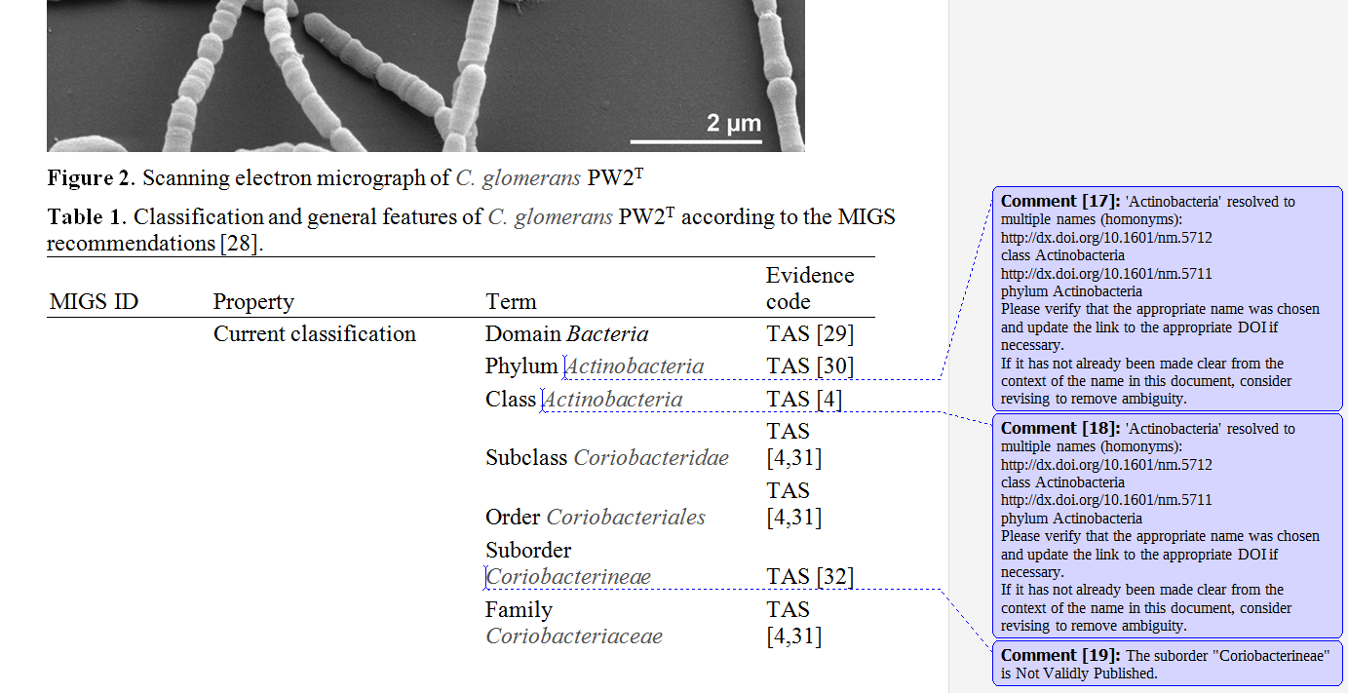
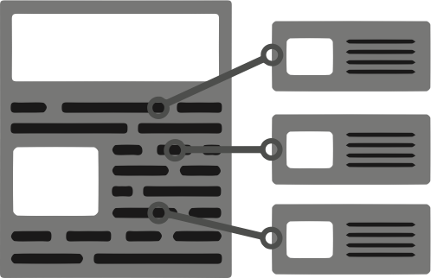
Scribe: Document Annotation Service
Document Annotation
Semantic Enrichment
Finds problems
Suggests corrections
XML, HTML, plain text
Microsoft Word
Microsoft Excel
OpenOffice/LibreOffice
https://namesforlife.com
Copyright ©2018 NamesforLife, LLC
All rights reserved

Slide 14
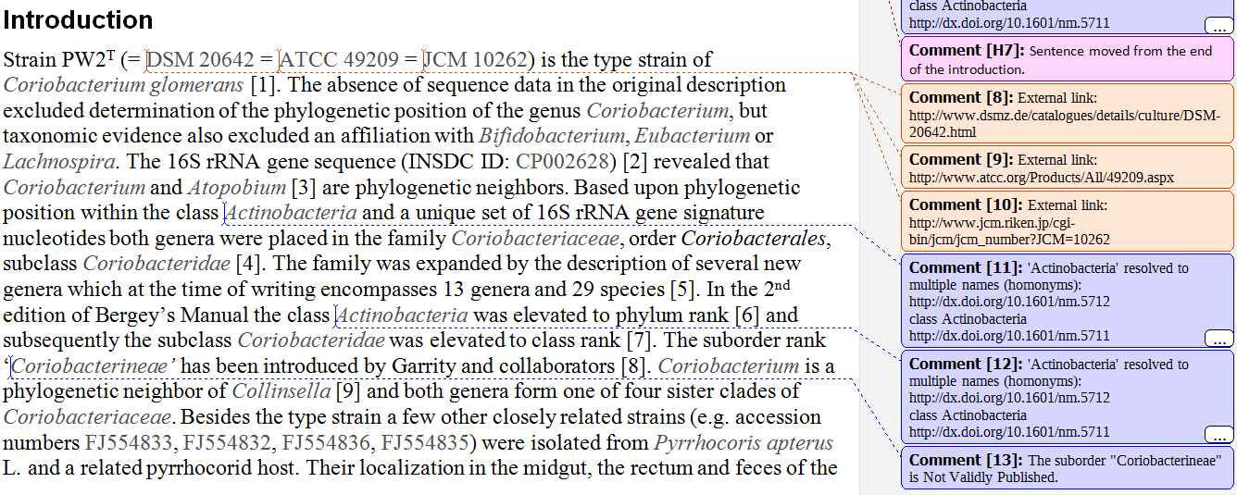

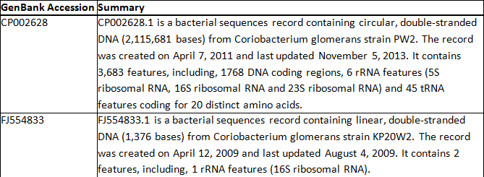
Scribe: Manuscript Fact Checking Service
The Scribe summarizes the content of remote resources and provides that information as a comment or in a summary at the end of the document.
https://namesforlife.com
Copyright ©2018 NamesforLife, LLC
All rights reserved

Slide 15
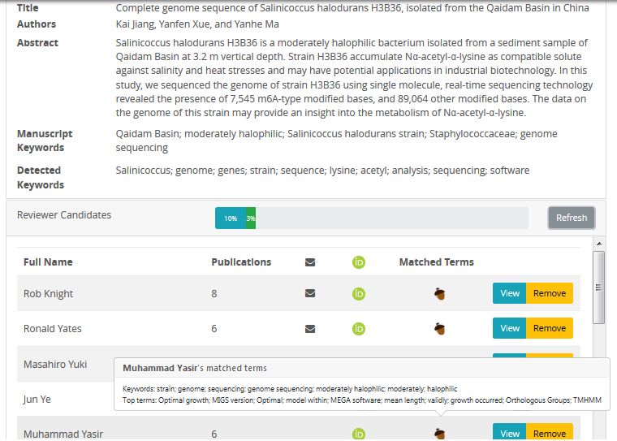

Peer Reviewer Recommendation Service
https://namesforlife.com
Copyright ©2018 NamesforLife, LLC
All rights reserved
Notes:
HiddenMetrixTM
Need to describe how the service is set up to automatically scan a manuscript and to find qualified reviewers based on a comparative analysis of the prospective reviewers publications in a topically related area. The algorithm ranks potential reviewers and ensures that each has a minimum number of peer-reviewed publication over the past five years. Some screening of potential COI is also performed. Invitation letters are automatically generated and made available to editors/authors for modification.
Currently runs in stand-alone mode.

Slide 16
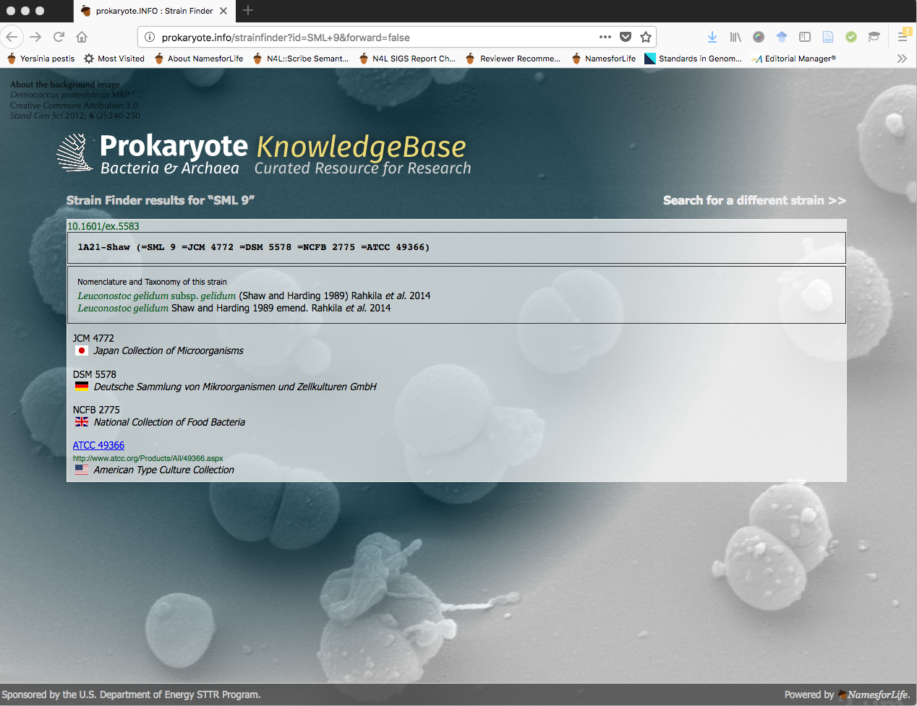
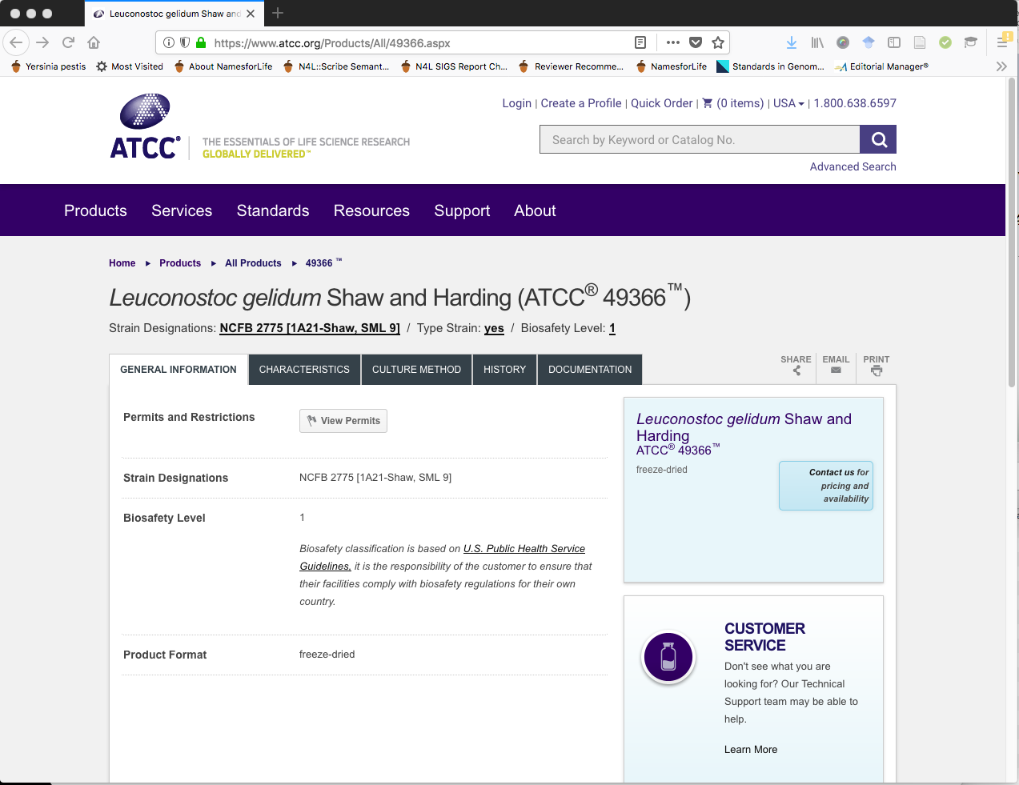
https://namesforlife.com
Notes:
Prokaryote.info is another novel approach to the use of DOIs for identifying information in published content. It uses a single DOI that is embedded into the publisher’s XML and the collection ID as an identifier. For those collections that have a URL that conforms to the guidelines that we discussed in 2014 with this RCN, we are able to provide a resolution service that requires very little effort to implement, immediately that will support monitoring and tracking of each strain in your holdings.

Slide 17
Integration with NamesforLife’s web services
URL conformance
Collection identifiers should map consistently into
https://www.my-agency.org/{COLLECTION)/{ACCESSION}
Collection description standard
Documentation of appropriate contacts within organization
  Requirements for depositing/acquiring materials
  Accession -> URL mapping
  Brief descriptions of resources
  Creation of a schema.org description
Metadata standards for resources
Provide standard method for documenting source material
Where possible, employ current URI mapping schemes
Employ other emerging standards (e.g., ORCID, N4L, Researcher ID)
Document available phenotypic data consistently using Semantic Web standards (SKOS, ontologies)
https://namesforlife.com
Copyright ©2018 NamesforLife, LLC
All rights reserved
Notes:
Point 1 - This would take relatively little effort for most collections as every major web server platform has a method of performing URL substitution (mapping). Don’t force everyone else to do it.
where (COLLECTION) is a string representing individual collection within an institution.
where (ACCESSION) is URI-mapped accession to that collection
Rationale - provides support of multiple collections within a single organization, maps directly to Search Engine Optimization, and to REST (Representational State Transfer).
http://www.atcc.org/Products/All/{ACCESSION_SUFFIX}.aspx
ATCC accessions are “ATCC 3944”, URL leaves off collection
ID.https://www.dsmz.de/catalogues/details/culture/{ACCESSION_PREFIX}-{ACCESSION_SUFFIX}.htmlDSMZ accessions are “DSM 7”, URL form is “DSM-7”.
Both of the above examples at least do this consistently throughout their collections, but they do require special handling. Ok for one or two collections, but when 500 collections all have different undocumented methods for accession->resource mapping (with at least 10 collections changing each year), it is unmaintainable for consistent linking and is hiding/obscuring your resources from the people who are trying to find them.
Many smaller collections have accessions, but offer no way to link directly to a resource:
There were a variety of different approaches in use when we spoke on this previously. It is clear from our current work that many of the collections still remain inaccessible to potential clients
schema.org is an informal taxonomy of concepts that appear in web pages. Medicine and pharmaceuticals are represented (poorly). Culture collections should get together and decide what the important concept taxonomy is for their field before the search engines do it for them.
This also provides a good lead in for the metadata standard on the next slide.

Slide 18
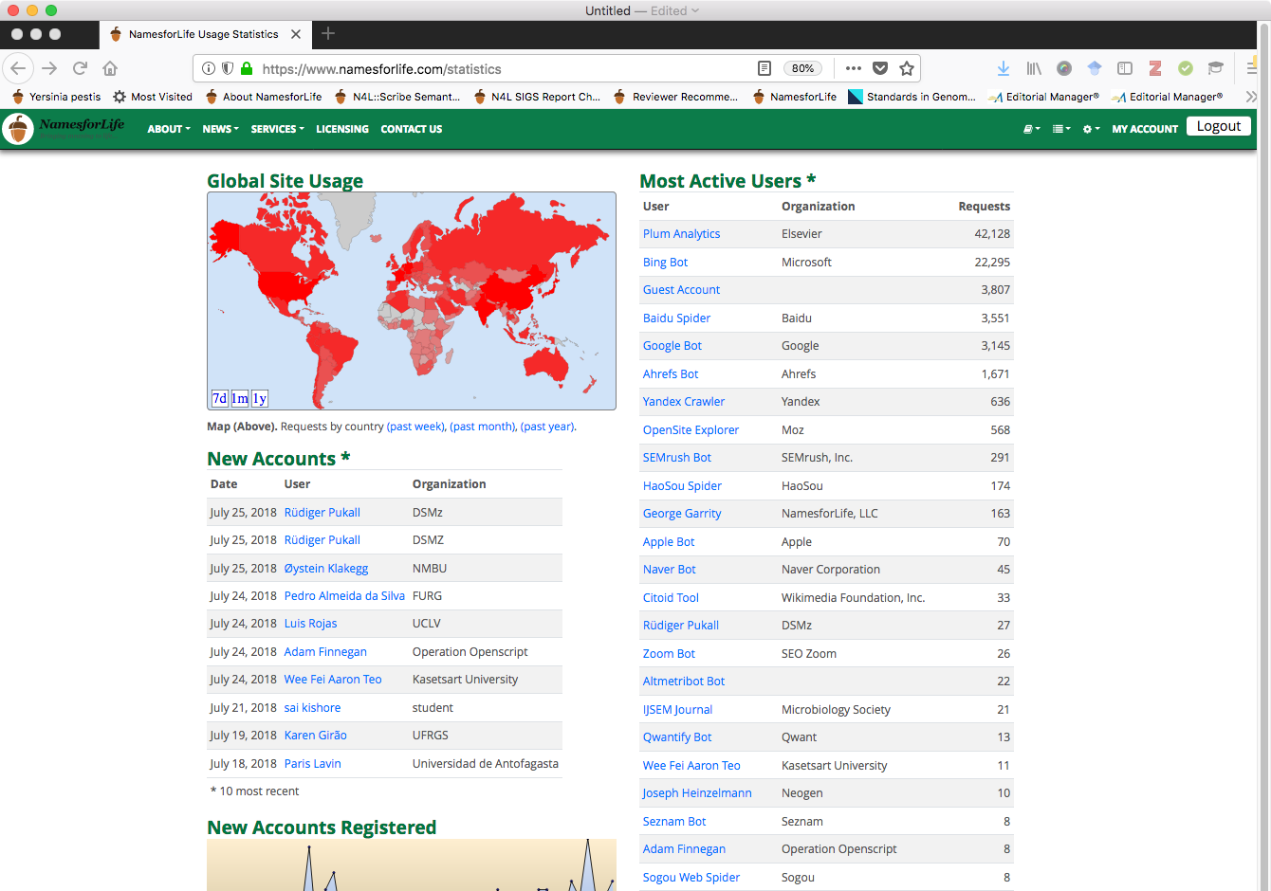
Guide: Tracking Usage
https://namesforlife.com
Copyright ©2018 NamesforLife, LLC
All rights reserved

Slide 19
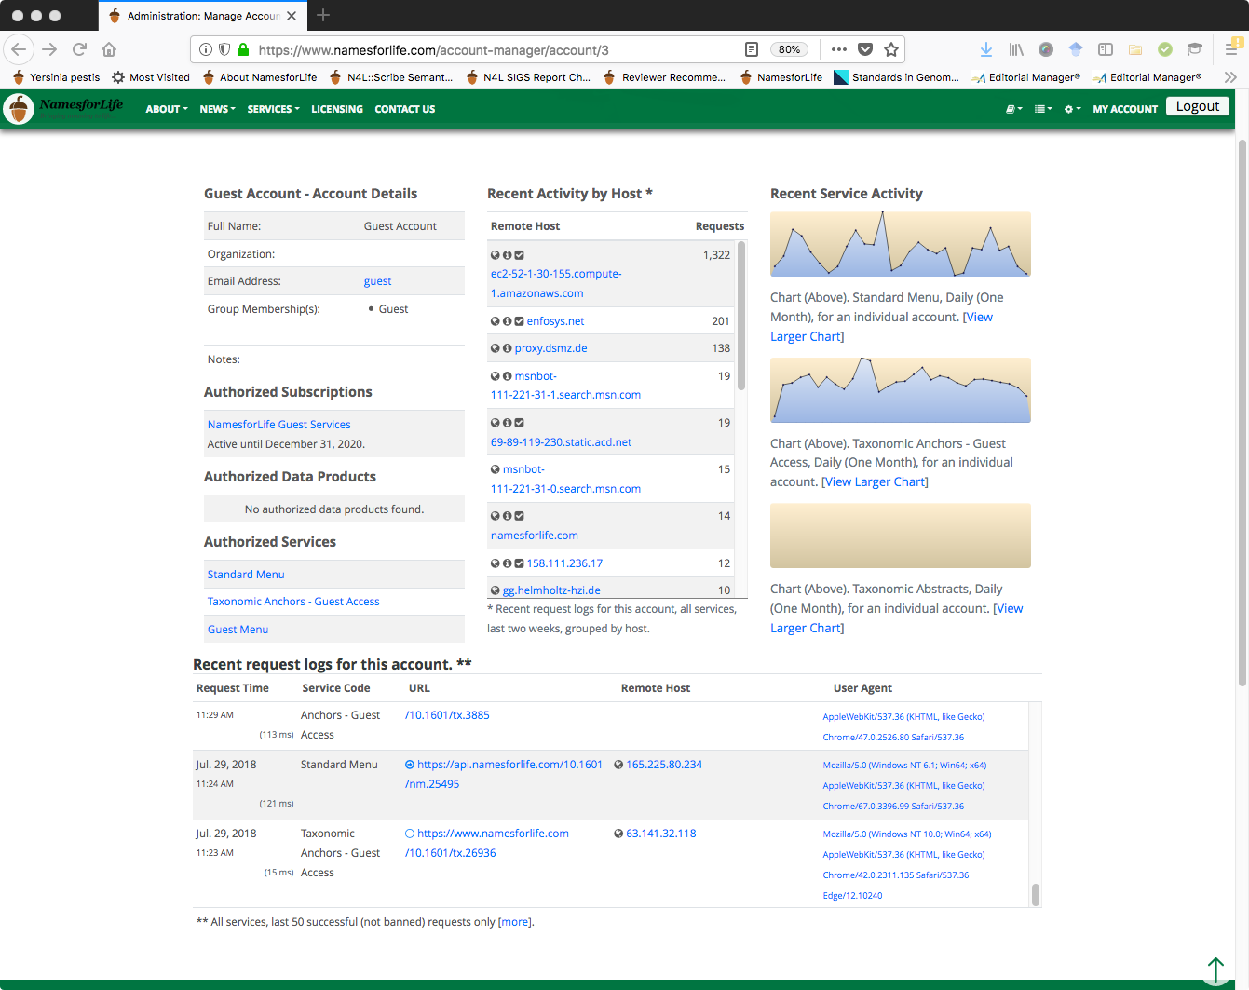
Guide: Tracking Usage
http://ijs.microbiologyresearch.org/content/journal/ijsem/10.1099/ijsem.0.002596
https://namesforlife.com
Copyright ©2018 NamesforLife, LLC
All rights reserved

Slide 20
Some closing thoughts
Culture collections are high-value assets
Repositories of well characterized research artifacts
Rich metadata that describes those artifacts
Historical value or current/future value?
New products/services
What’s the competition
How to reach new users
Discoverability
NamesforLife offers ways to make your strains and collection discoverable
NamesforLife can monitor/track historical and current usage
System and methods are proven, requires very modest effort to exploit
If your organization wants to be involved in the next steps, contact me at garrity@namesforlife.com
Notes:
Call to Action
We want to give more exposure to specimens in your collections.
We can put individual specimens from your catalog in front of thousands of readers in a way that nobody else can.
We already have the foundation for this system up and running, and we want your input and cooperation to take this to the next step.
I'm here until Wednesday afternoon, and if you're interested in being a part of this, just catch me in the hallway and I'd be happy to talk to you about it.

Slide 21









NamesforLife
Bringing meaning to life ...
Roman A. Barco
Charles T. Parker
Nicole Osier
Vo Phan Chuong
Dorothea Taylor
Kara Mannor
Dave Ussery
Michael Robeson
Trudy Wassenar
Sarah Wigley
Grace Rodriguez
Amber Roberts
Danny Bakoz
Terry Marsh
Ashley Shade
John Guittar
Keven Petersen
Nenad Krdzavac
Nikos Kyrpides
Neha Varghese
TBK Reddy
This work was funded through the Small Business Technology Transfer program of the United States Department of Energy under grants number DE-FG02-07ER86321 and DE-SC0006191. Funding for business development was provided through grants and loans from the Michigan Economic Development Corporation and the Michigan Universities Commercialization Initiative. NamesforLife semantic resolution technology is covered under US Patent 7,925,444 B2. The SOSCC systems and methods is covered under US Patent 8,036,997. Semiotic fingerprinting is covered under US 8,903,824. Semantic tagging, indexing, equivalency mapping, and latent semantic analysis of molecular sequence data are the subjects of pending US and EPO patent applications.
https://namesforlife.com
Copyright ©2018 NamesforLife, LLC
All rights reserved

